Slide 1

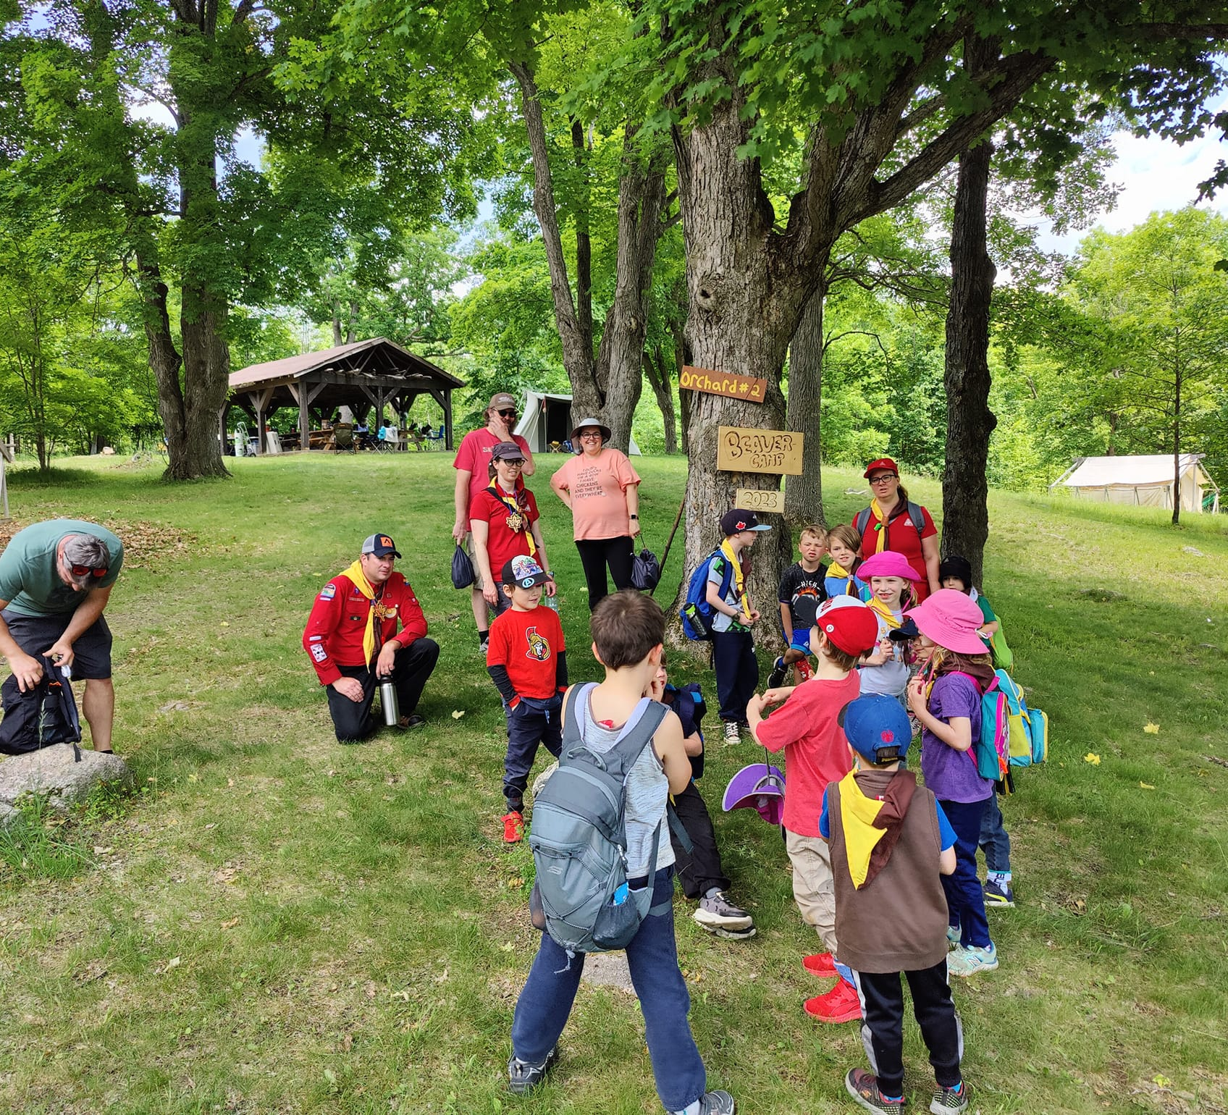
Voyageur Council Birthday Bonanza
Scouter Information Session #4
May 26, 2024

Slide 2
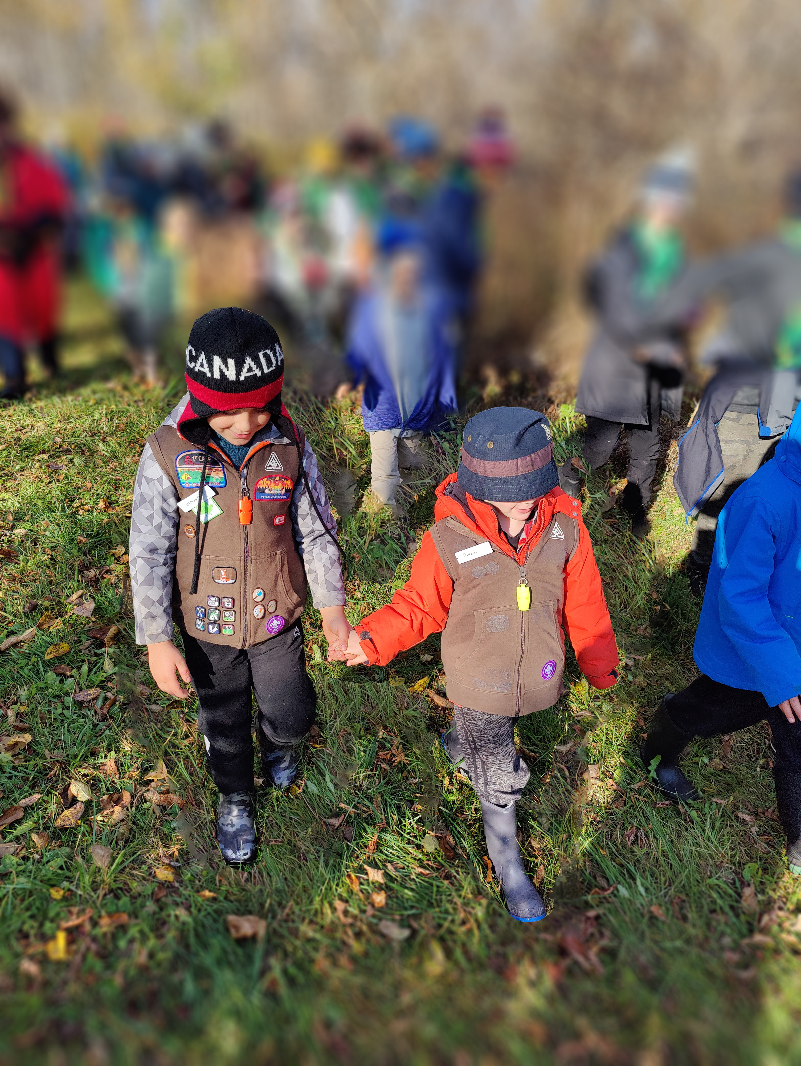
Agenda
Welcome Scouters!
Where are we, and what do we have?
Day of…
  Transportation (aka, bus fun!)
  Arriving at Beckwith
  Opening
  Activities
  Virtual Campfire
  Departures
What’s next?
Q&A

Slide 3
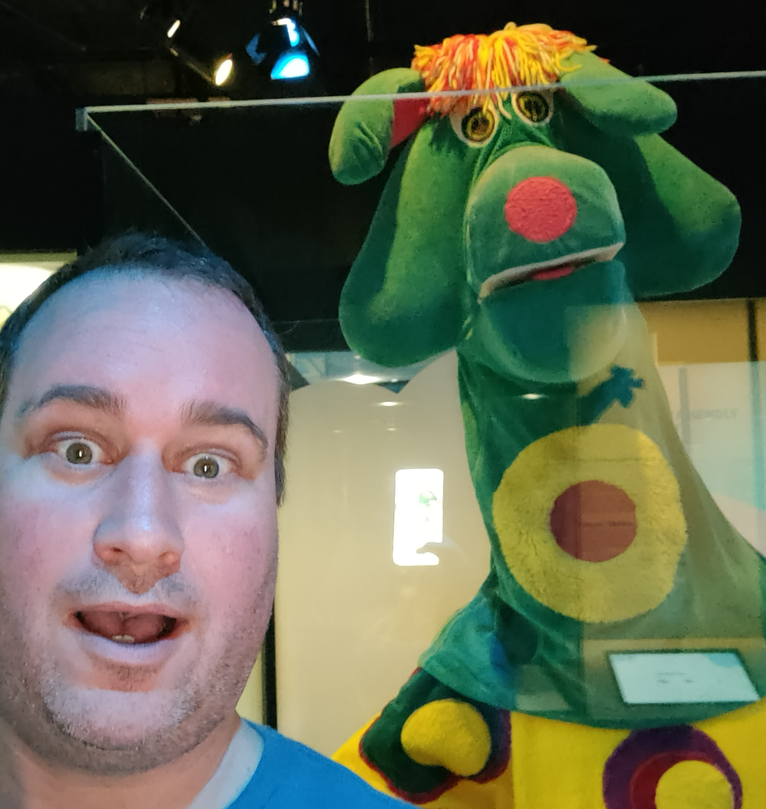
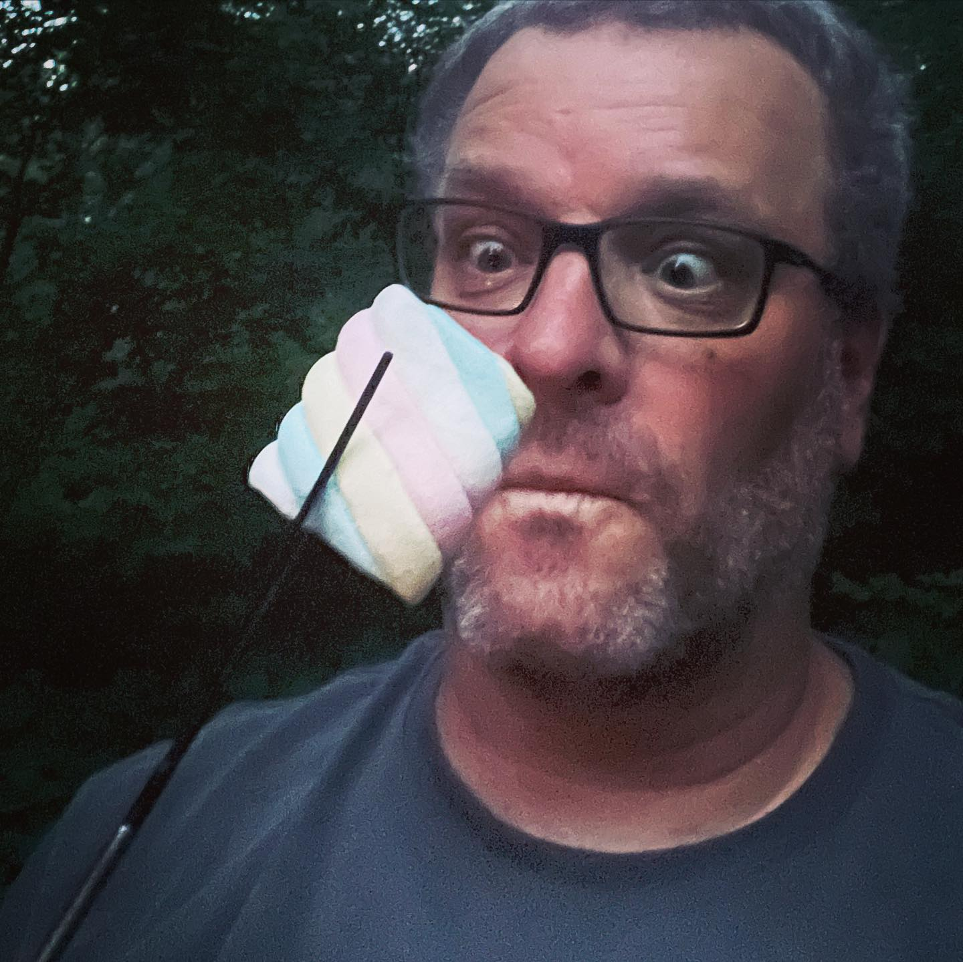
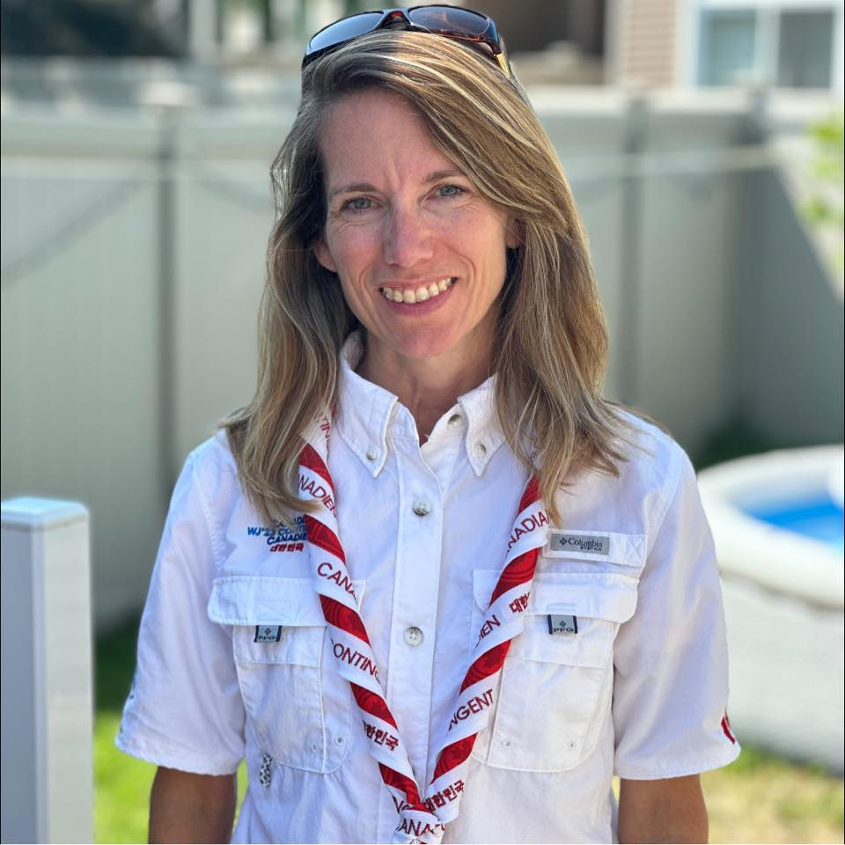
Meet our admin team
Jeff Reid
Marc Chamberland
Susie James
Event Chair
jeff.reid@scouts.ca
Deputy Chair
mchamberland@scouts.ca
Registrar & Treasurer
sjames@scouts.ca

Slide 4
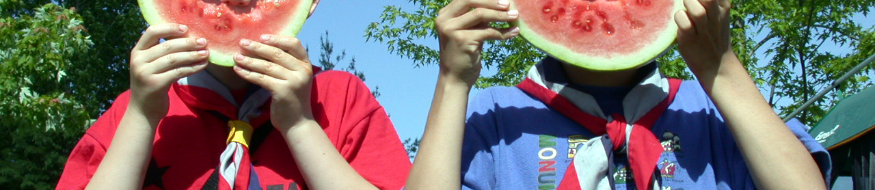
What do we have?
What is available for you?
What do you need to do?
ERP
50th songbook & Herman the Worm
Transportation info
Screening requirements
Complete your AAF
Ensure parents show up on time (helps if they’re there on time for pick-up too…)
Practice Herman the Worm

Slide 5
What to Bring?
Scouters
First aid kit
Approved AAF
MDRs
Cell phone
Everyone!
In a backpack…
Litter-less school-safe lunch and snacks
Filled water bottle (with name on it)
Sunscreen & bug repellant
To wear…
Hat (bucket hat!)
Uniform
Comfortable closed toed shoes and socks
Ready for the weather!
  Rain gear
  Sweater
  Spare clothes
Nice to have…
Cooler for lunches
Tarp/blanket

Slide 6
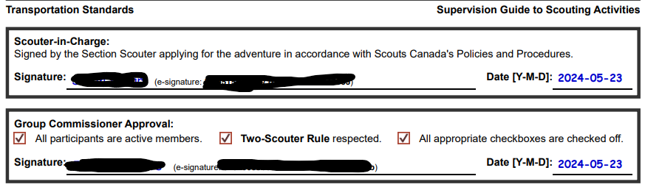
Is Your AAF Already Approved?
If your AAF is already approved, or will be this week, then send it in advance! Ideally use ScoutsTracker, and print the AAF for us.
We only need the main AAF form!
Not any attachments, emergency
contact info, etc.
This means we won’t be asking for it at check-in, to speed up the process.
Send them to jeff.reid@scouts.ca and sjames@scouts.ca

Slide 7

It’s June 1st!
Time to part-ay!
Reminder: YOU are responsible for your Colony!

Slide 8
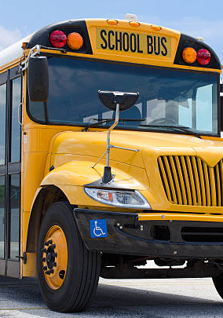
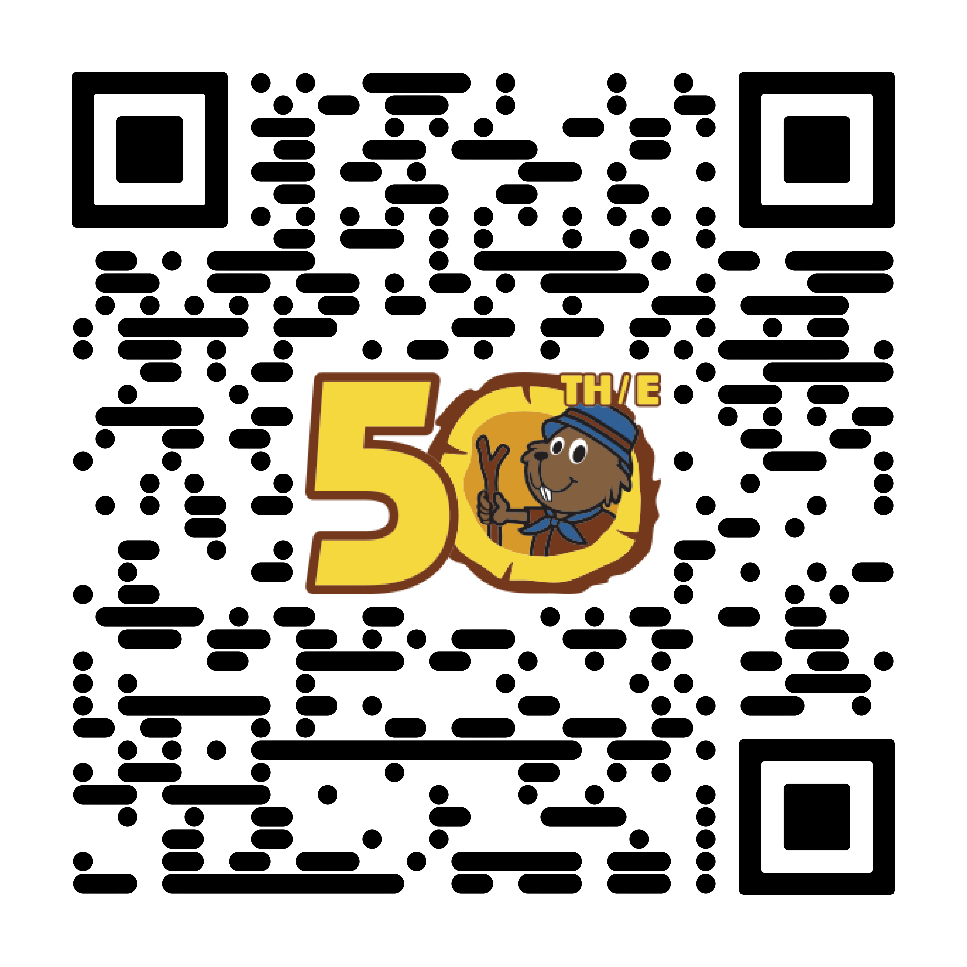
Transportation Update!
Buses will be timed for a 9:30am arrival at Beckwith.
Arrive early to check-in
Scouters are responsible for your Colony drop-offs (2 Scouters)
Buses will depart on time
Start the journey early!
Notes:
Buses will depart on time, with or without groups
We are not responsible for vehicles
https://www.beaver50th.ca/event/bus-pickup-points/

Slide 9
Transportation Update!
Busing details on website
https://www.beaver50th.ca/event/bus-pickup-points/
Changes:
Smith Falls (now Walmart)
Possibly Ottawa Core (Brookfield High School)
Emails will be sent out
Promptly if any changes.

Slide 10
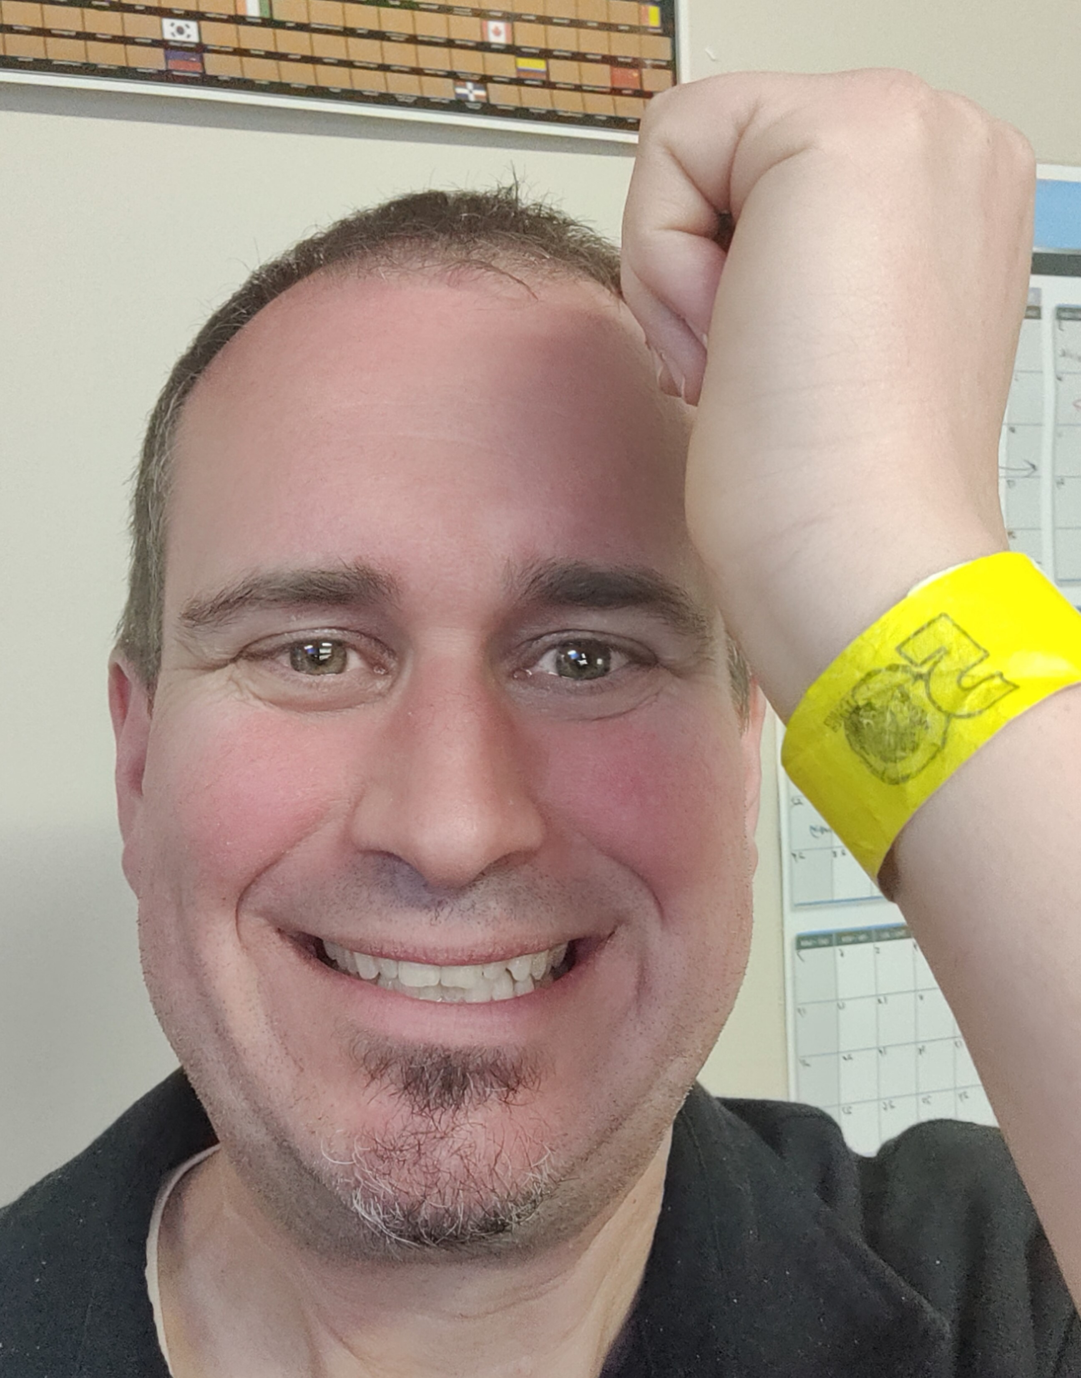
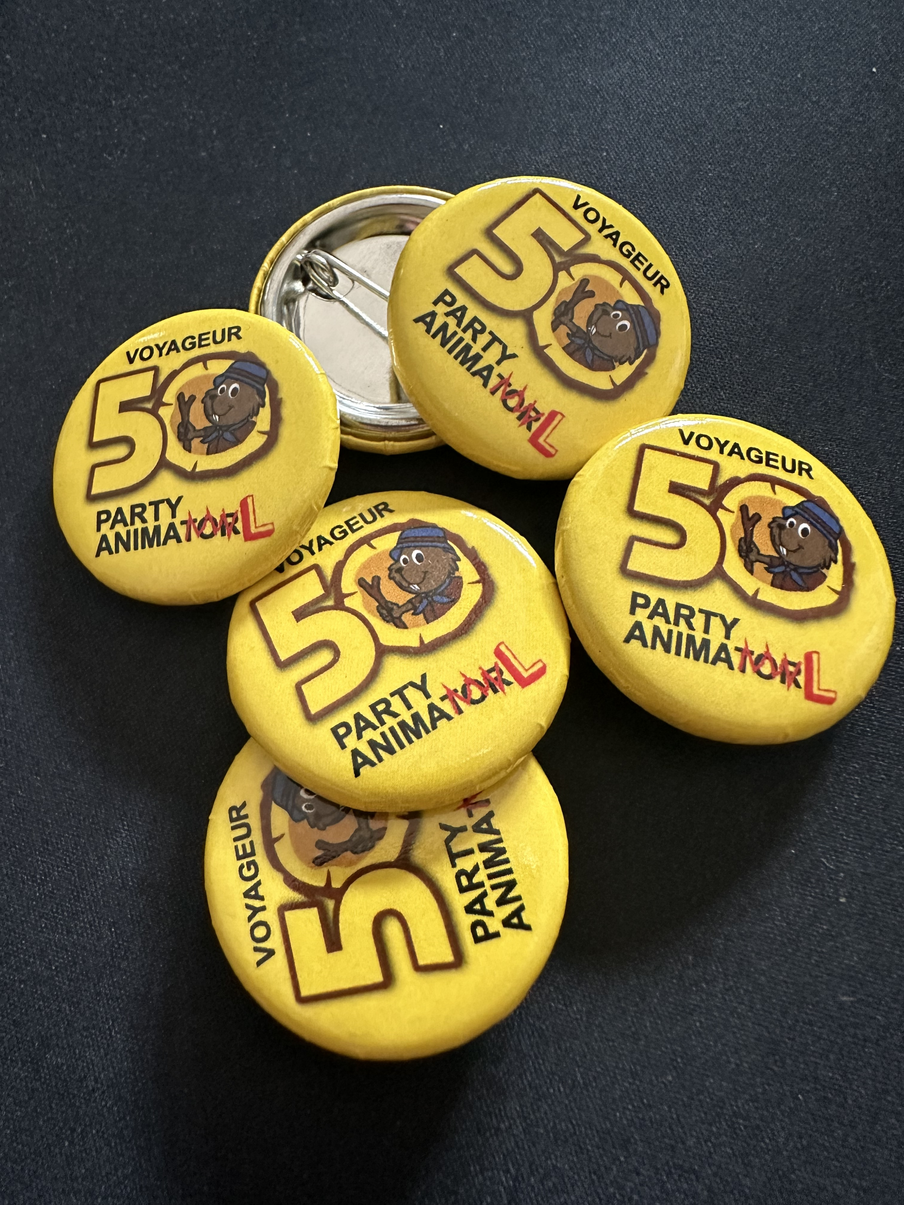
Wristbands
Wristbands will be handed out at your bus hub if a volunteer is assisting, or upon arrival. They’ll be colour-coded to a role, and have your group and Colony name on them!
BLUE = Beavers
RED = Scouters
GREEN = Parents + youth
YELLOW = OOS!

Slide 11
So you arrive at the event, now what?
Take everything
Go to the Indoor Field
Drop off your bags
View your info packet
Head back outside!
Buses will be leaving, take everything off!
Check-in, and find your Colony’s sign
We’ll have your rotation #, and activity schedule
This is Scouting, we go rain or shine!
This is your Colony’s safe spot… take water bottles, but leave lunches, etc. you don’t need

Slide 12
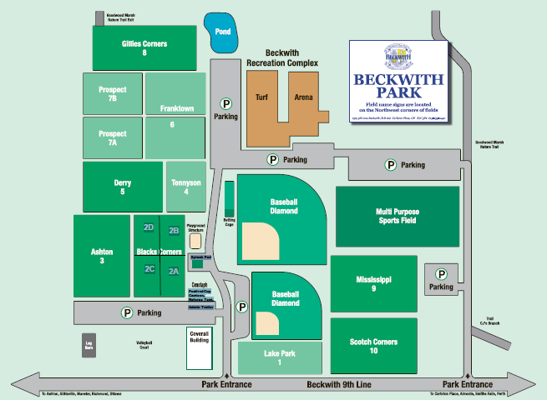
Facility
Washrooms
Water refills
& More!
Bag Drop
Rotation Area #1
Rotation Area #2
Rotation Area #3
Virtual Campfire
Out of Bounds
Out of Bounds

Slide 13
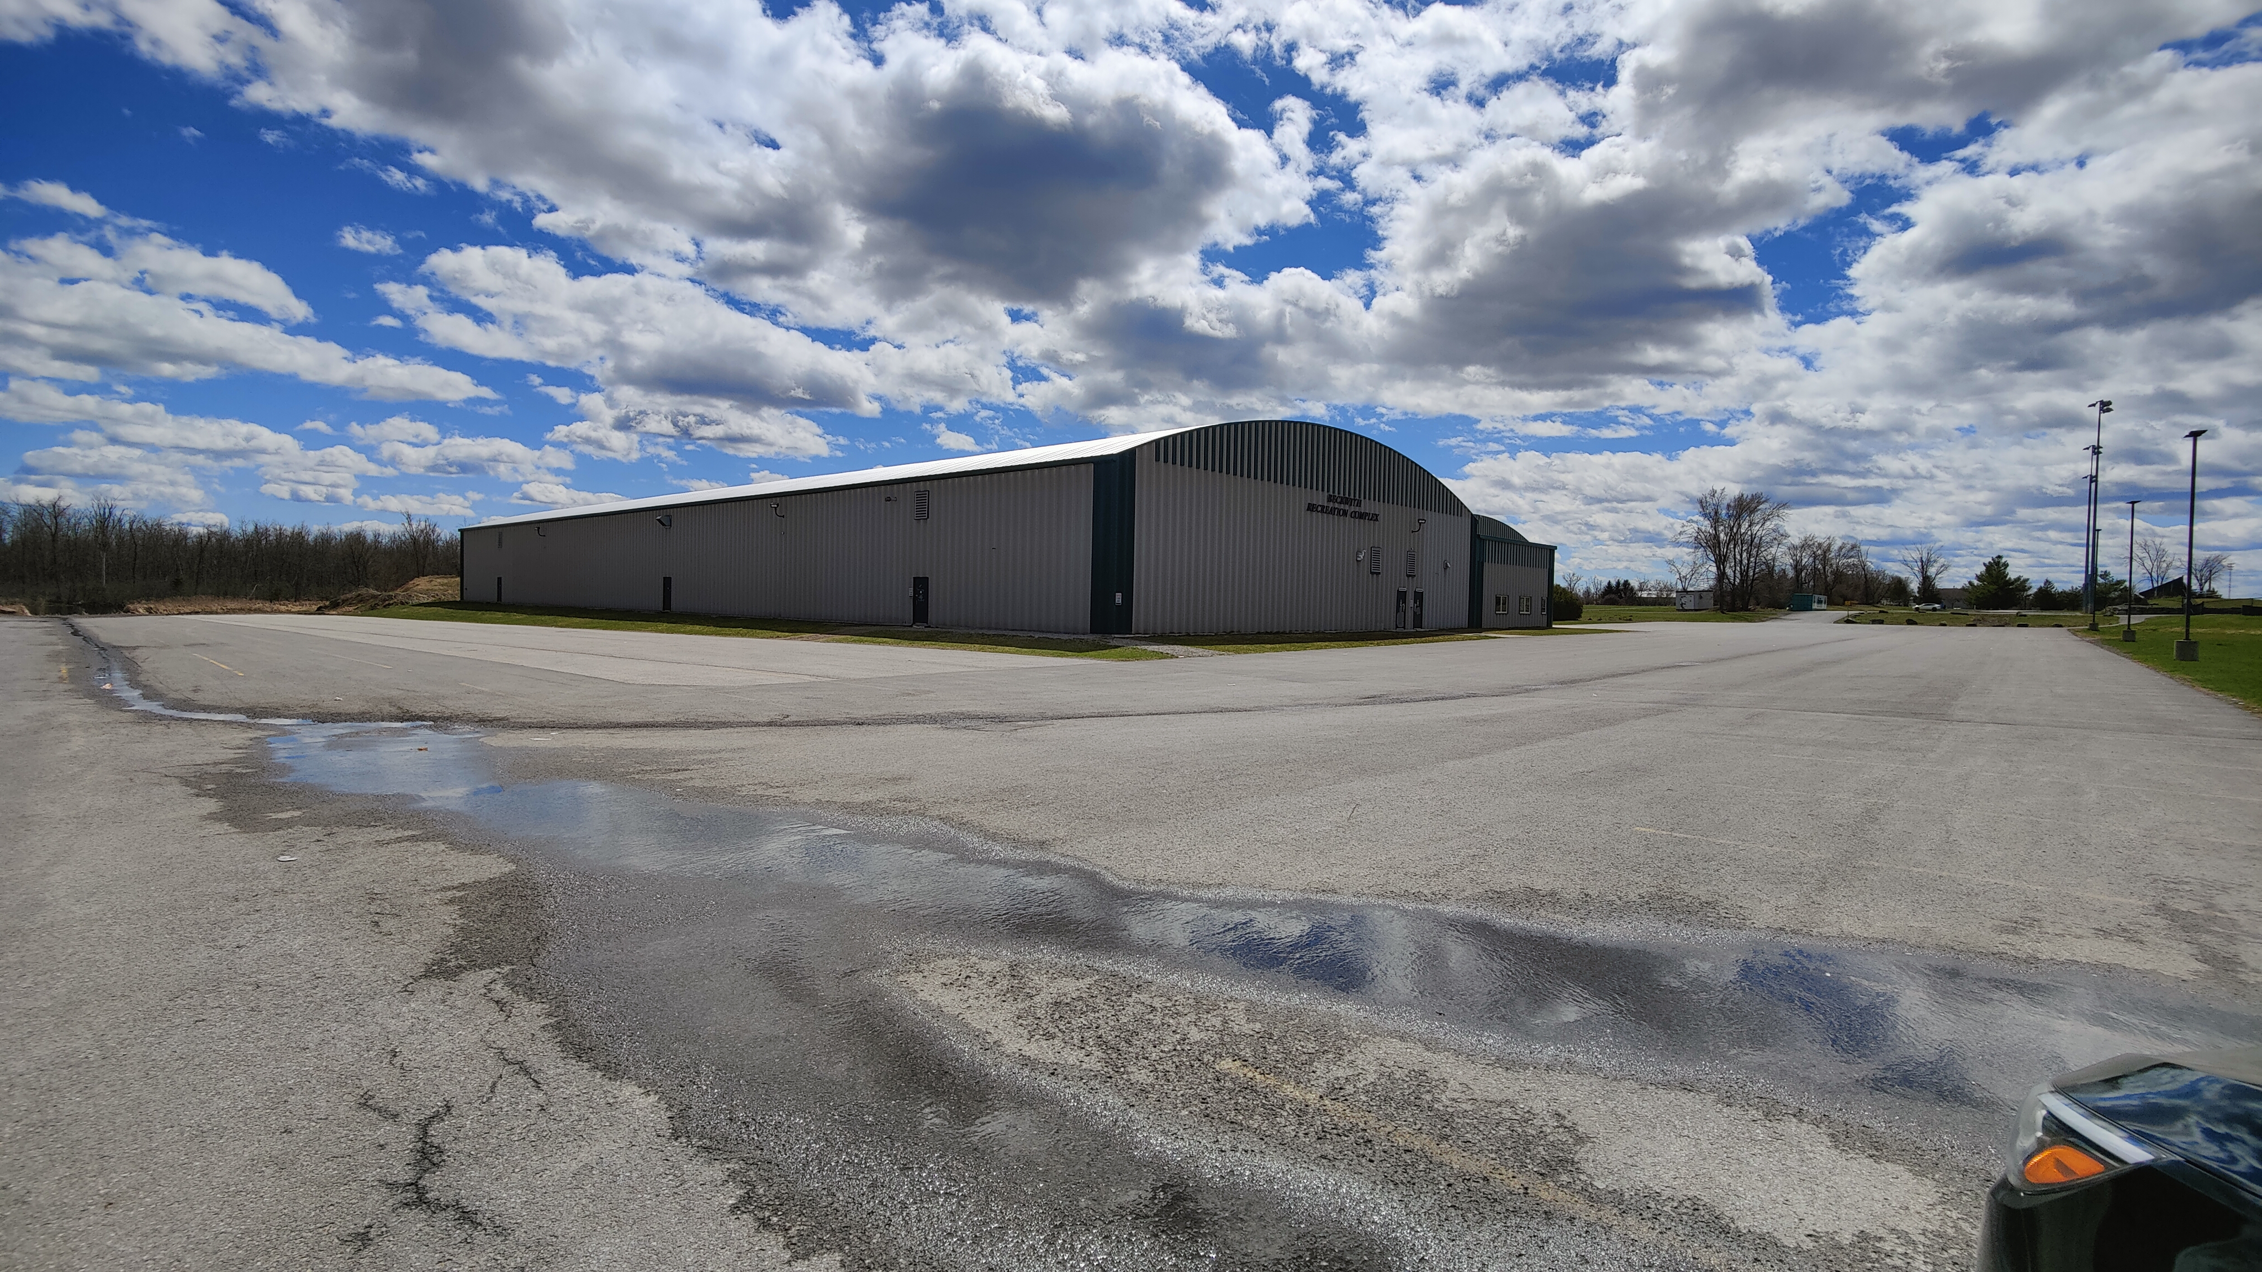
Bus Drop-Off Area
Indoor Turf
Barrier

Slide 14
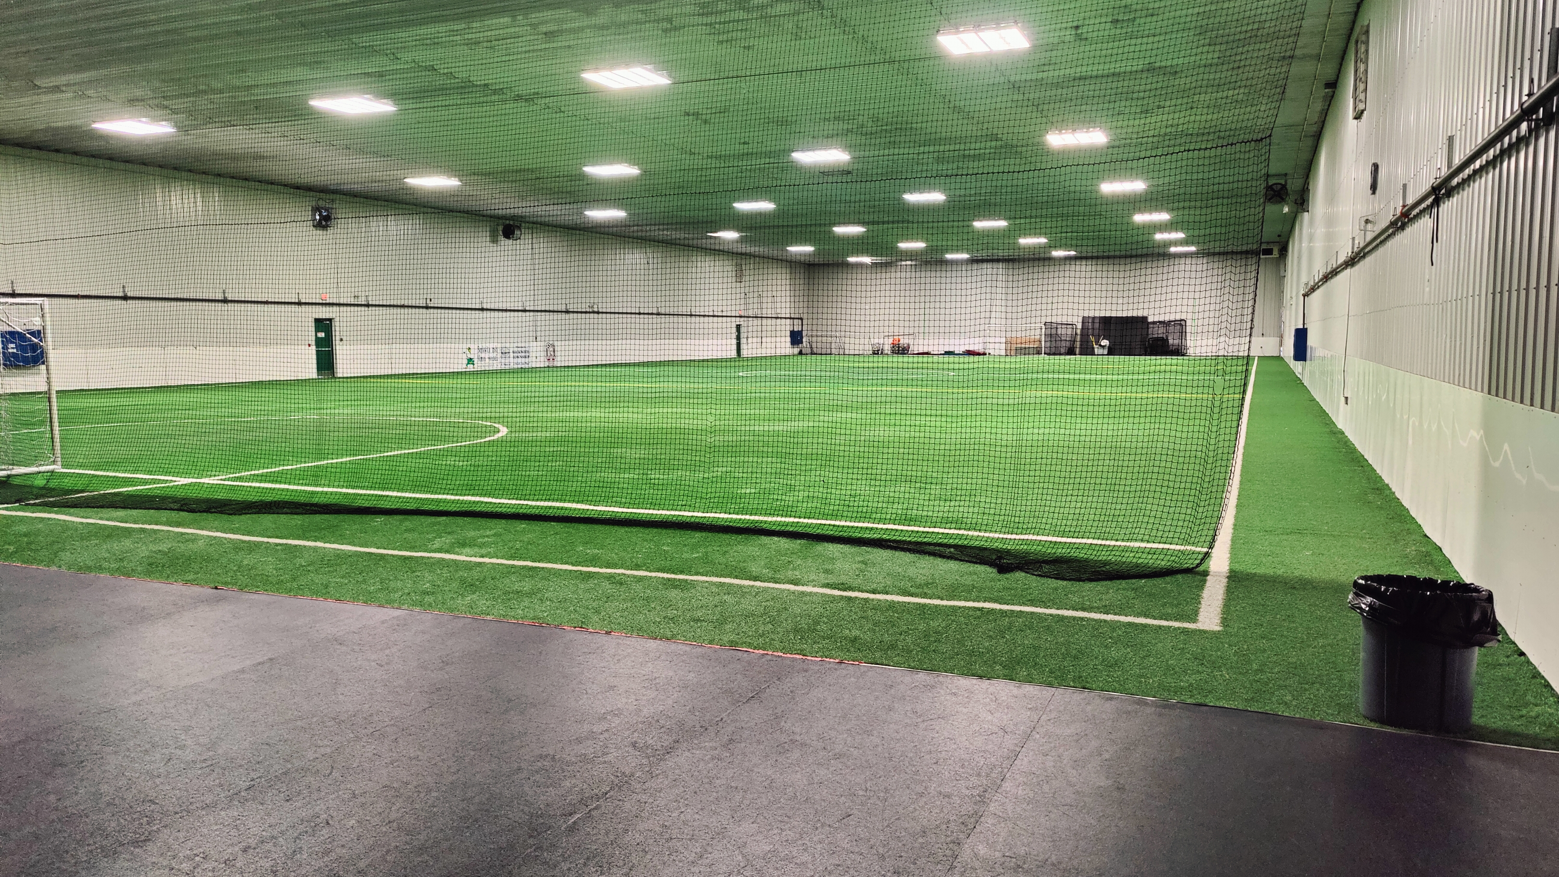
Indoor Turf (bag drop)

Slide 15
June 1st Timeline
7-8:30am
Bus hub arrivals, check-ins
9:30am
Attendees arrive, final check-ins
10:00am
Event opening
Our Song:
Herman the Worm!
10:30am
Activity rotations
12:00pm
Lunch
12:45pm
Activity rotations
2:00pm
Virtual campfire (nation-wide)
3:15pm
Activity rotations
4:00pm
Departures

Slide 16
Activity Rotations
Remember!
This is a birthday bash!
Activities will be designed for multiple Beavers to complete together
Colonies are attending as a Colony… their Scouters can help with running some activities
Many activities will require minimal supervision of OOS, depending on risk level
Registrar will create 27 “groups”
  Assigning 9 to each rotation area (one per activity)
  Average of 16-20 beavers per group
Colonies will have a chance to complete each activity, if they wish
  Scouters know their Beavers, they can take breaks or skip an activity
20 minute rotations, 5 mins travel

Slide 17
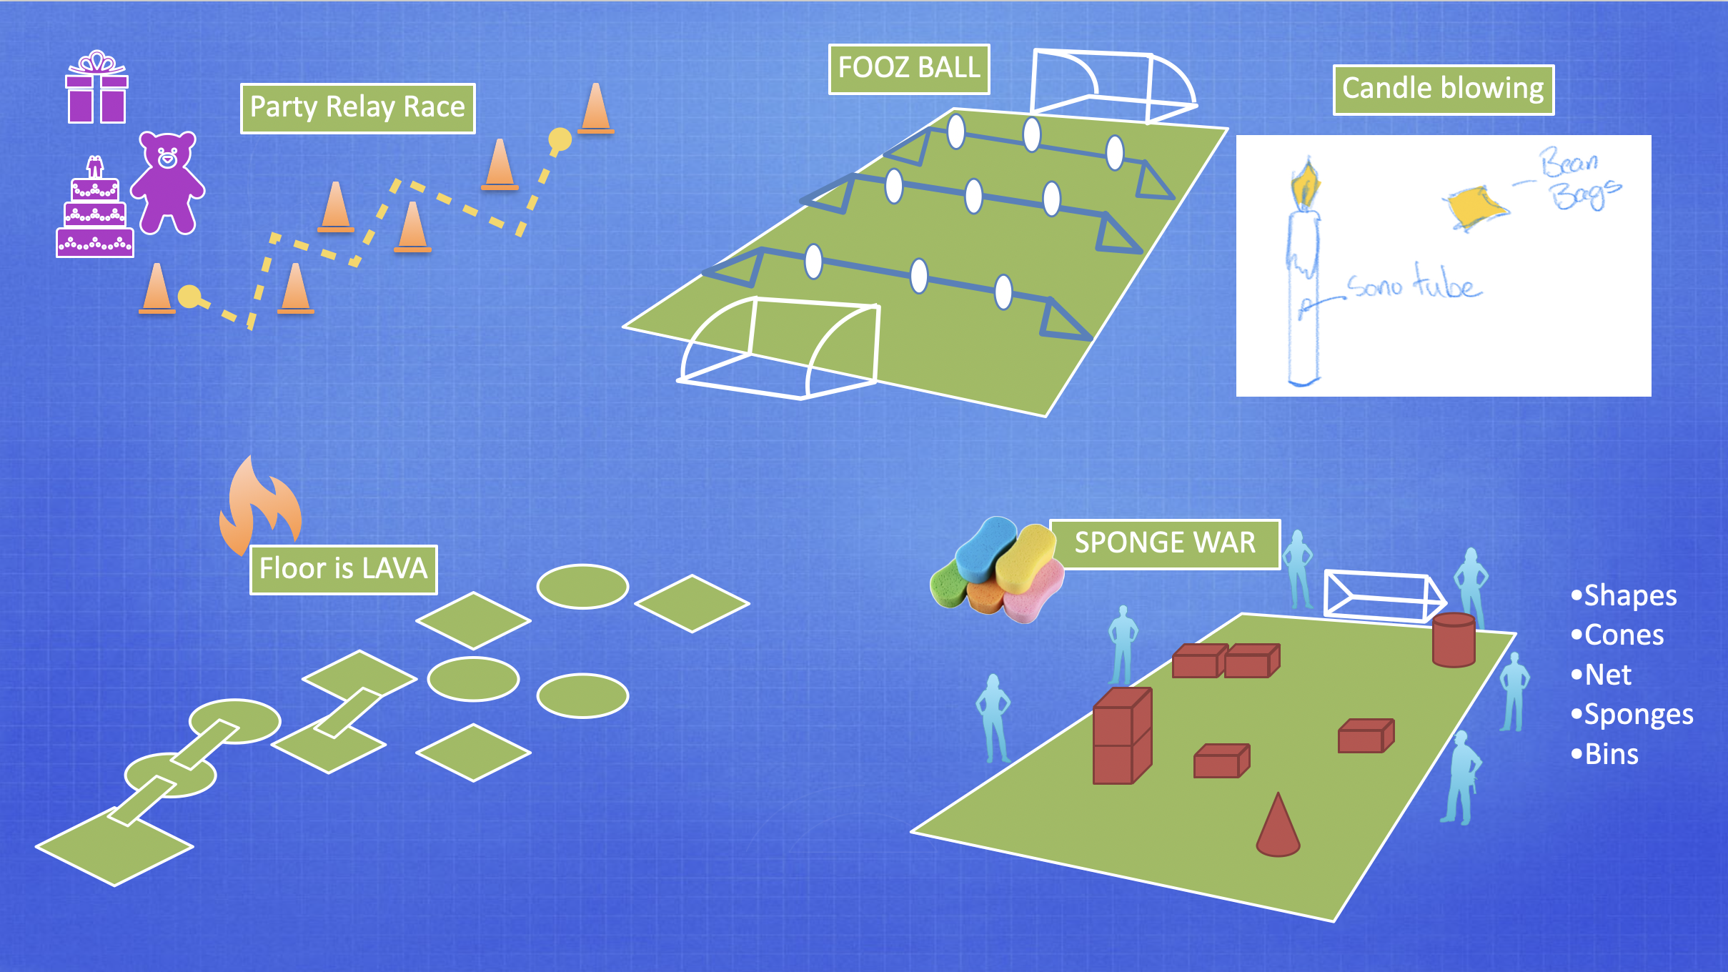
Did someone say… activities?

Slide 18
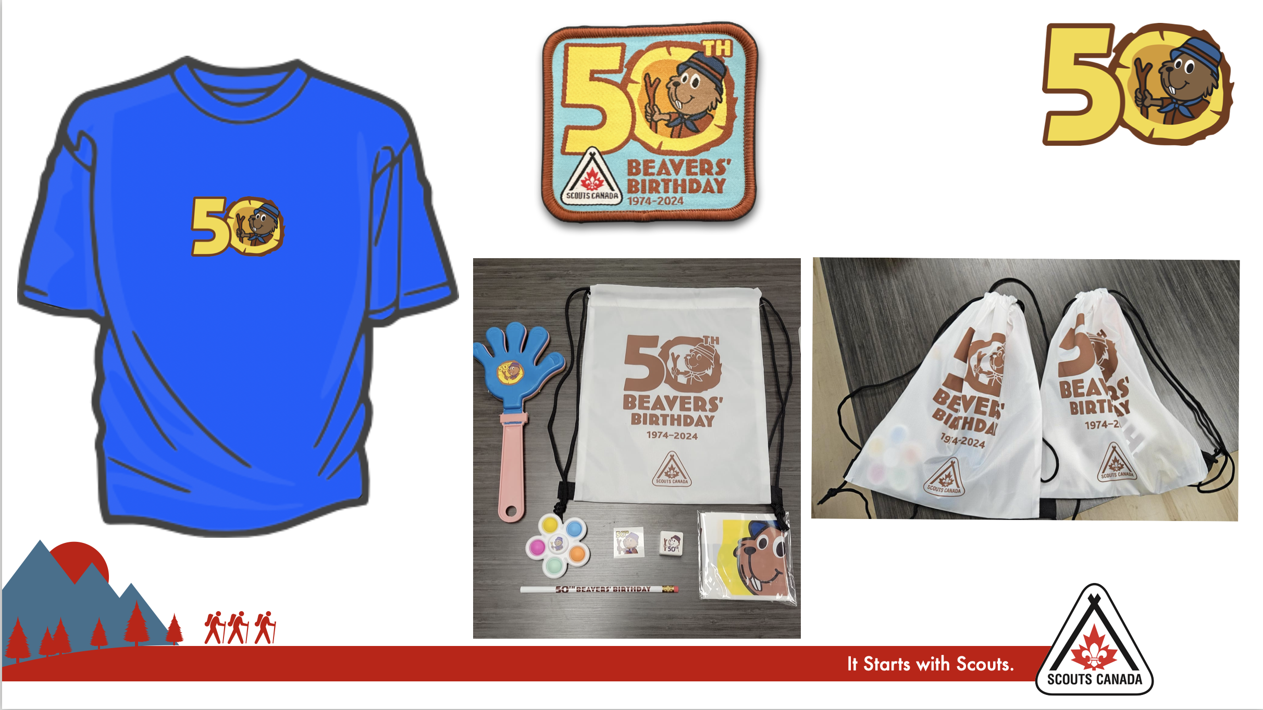
At the end of the day…. Swag!
Note: Unfortunately bucket hats are not available

Slide 19


Slide 20
Any Questions?
(Submit them on the website if you think of them later)

Slide 21
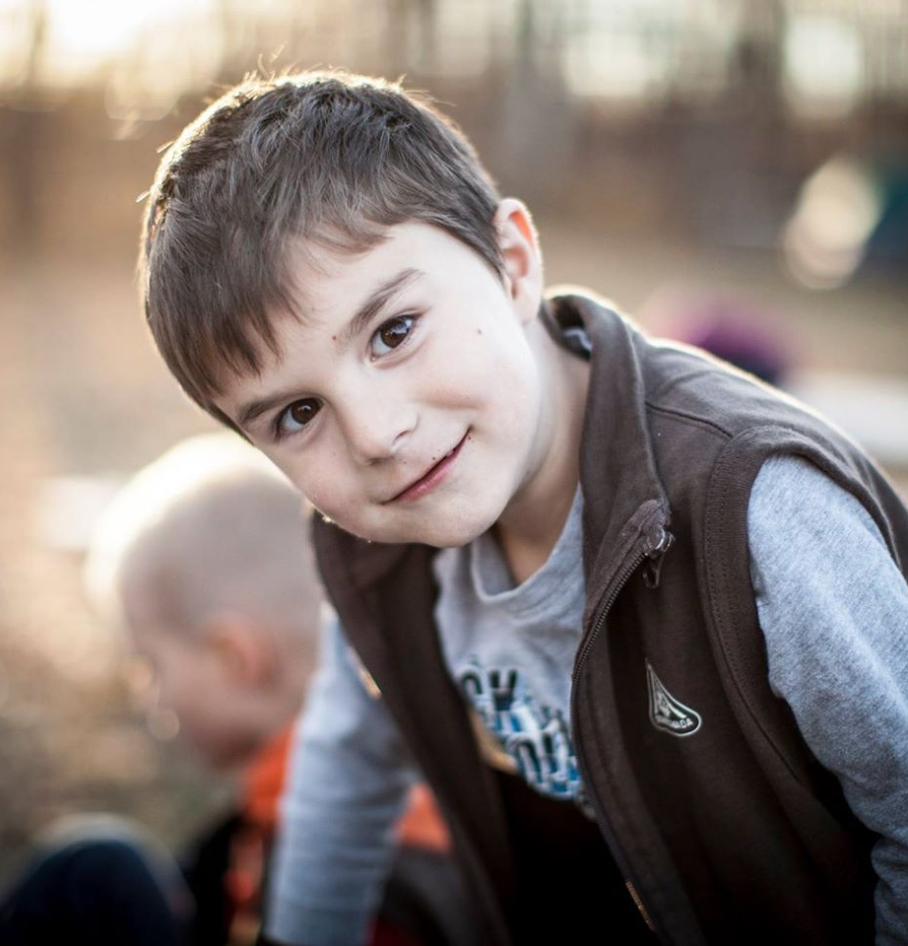
Resources!
Voyageur Beaver 50th Website!
https://www.beaver50th.ca/
Beaver 50th Newsletter
Sent out every 2 weeks to registered Colonies.
Contact Jeff Reid (jeff.reid@scouts.ca) anytime!

