Slide 1

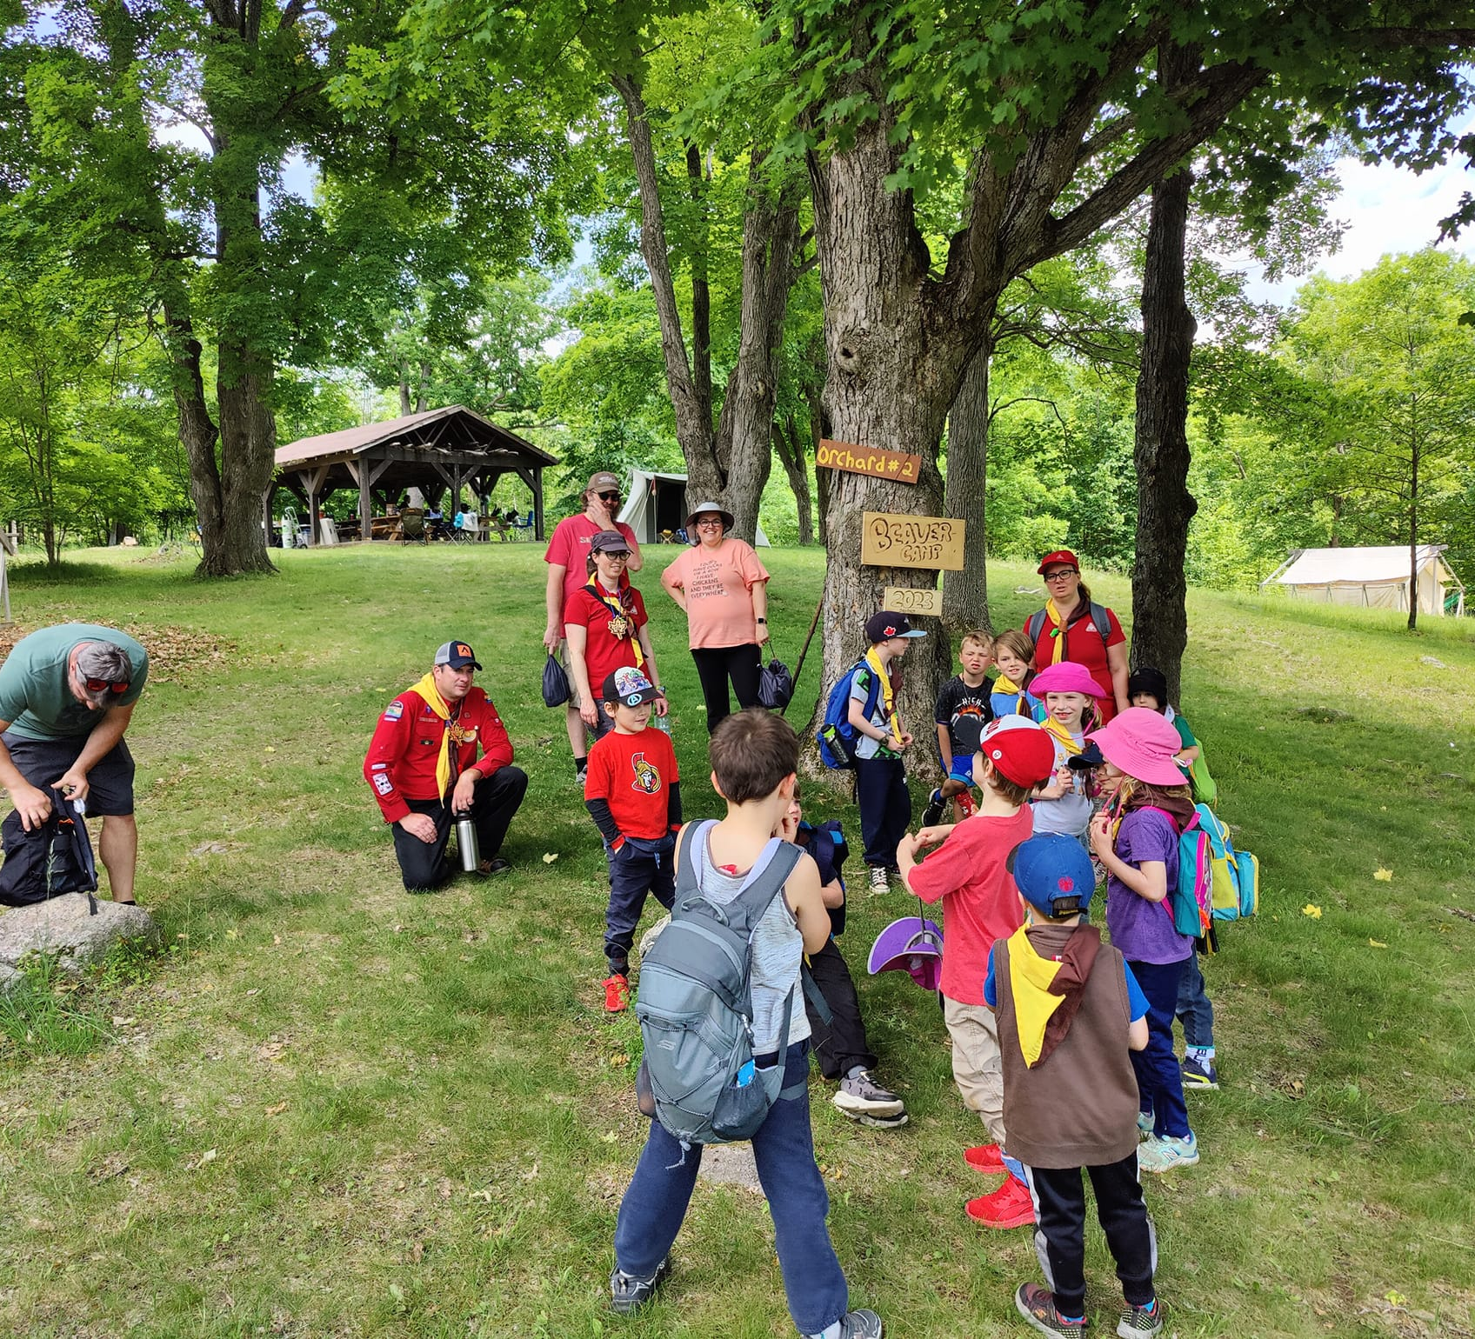
Voyageur Council Birthday Bonanza
Scouter Information Session #3
April 21, 2024

Slide 2
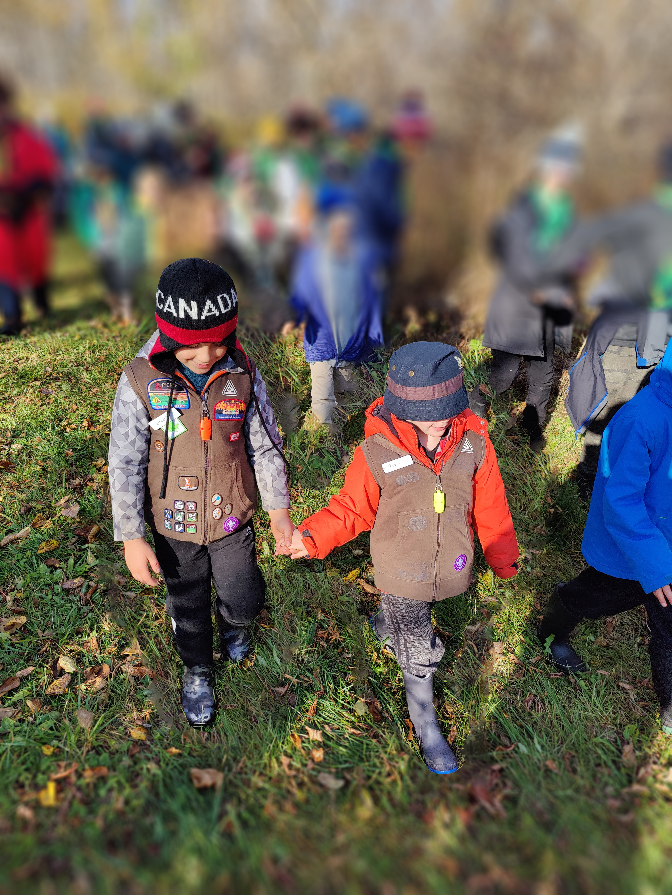
Agenda
Welcome Scouters!
Who is coming?
Timeline (what do I need, and when?)
Transportation (aka, bus fun!)
How will activities work?
What’s next?
Q&A

Slide 3
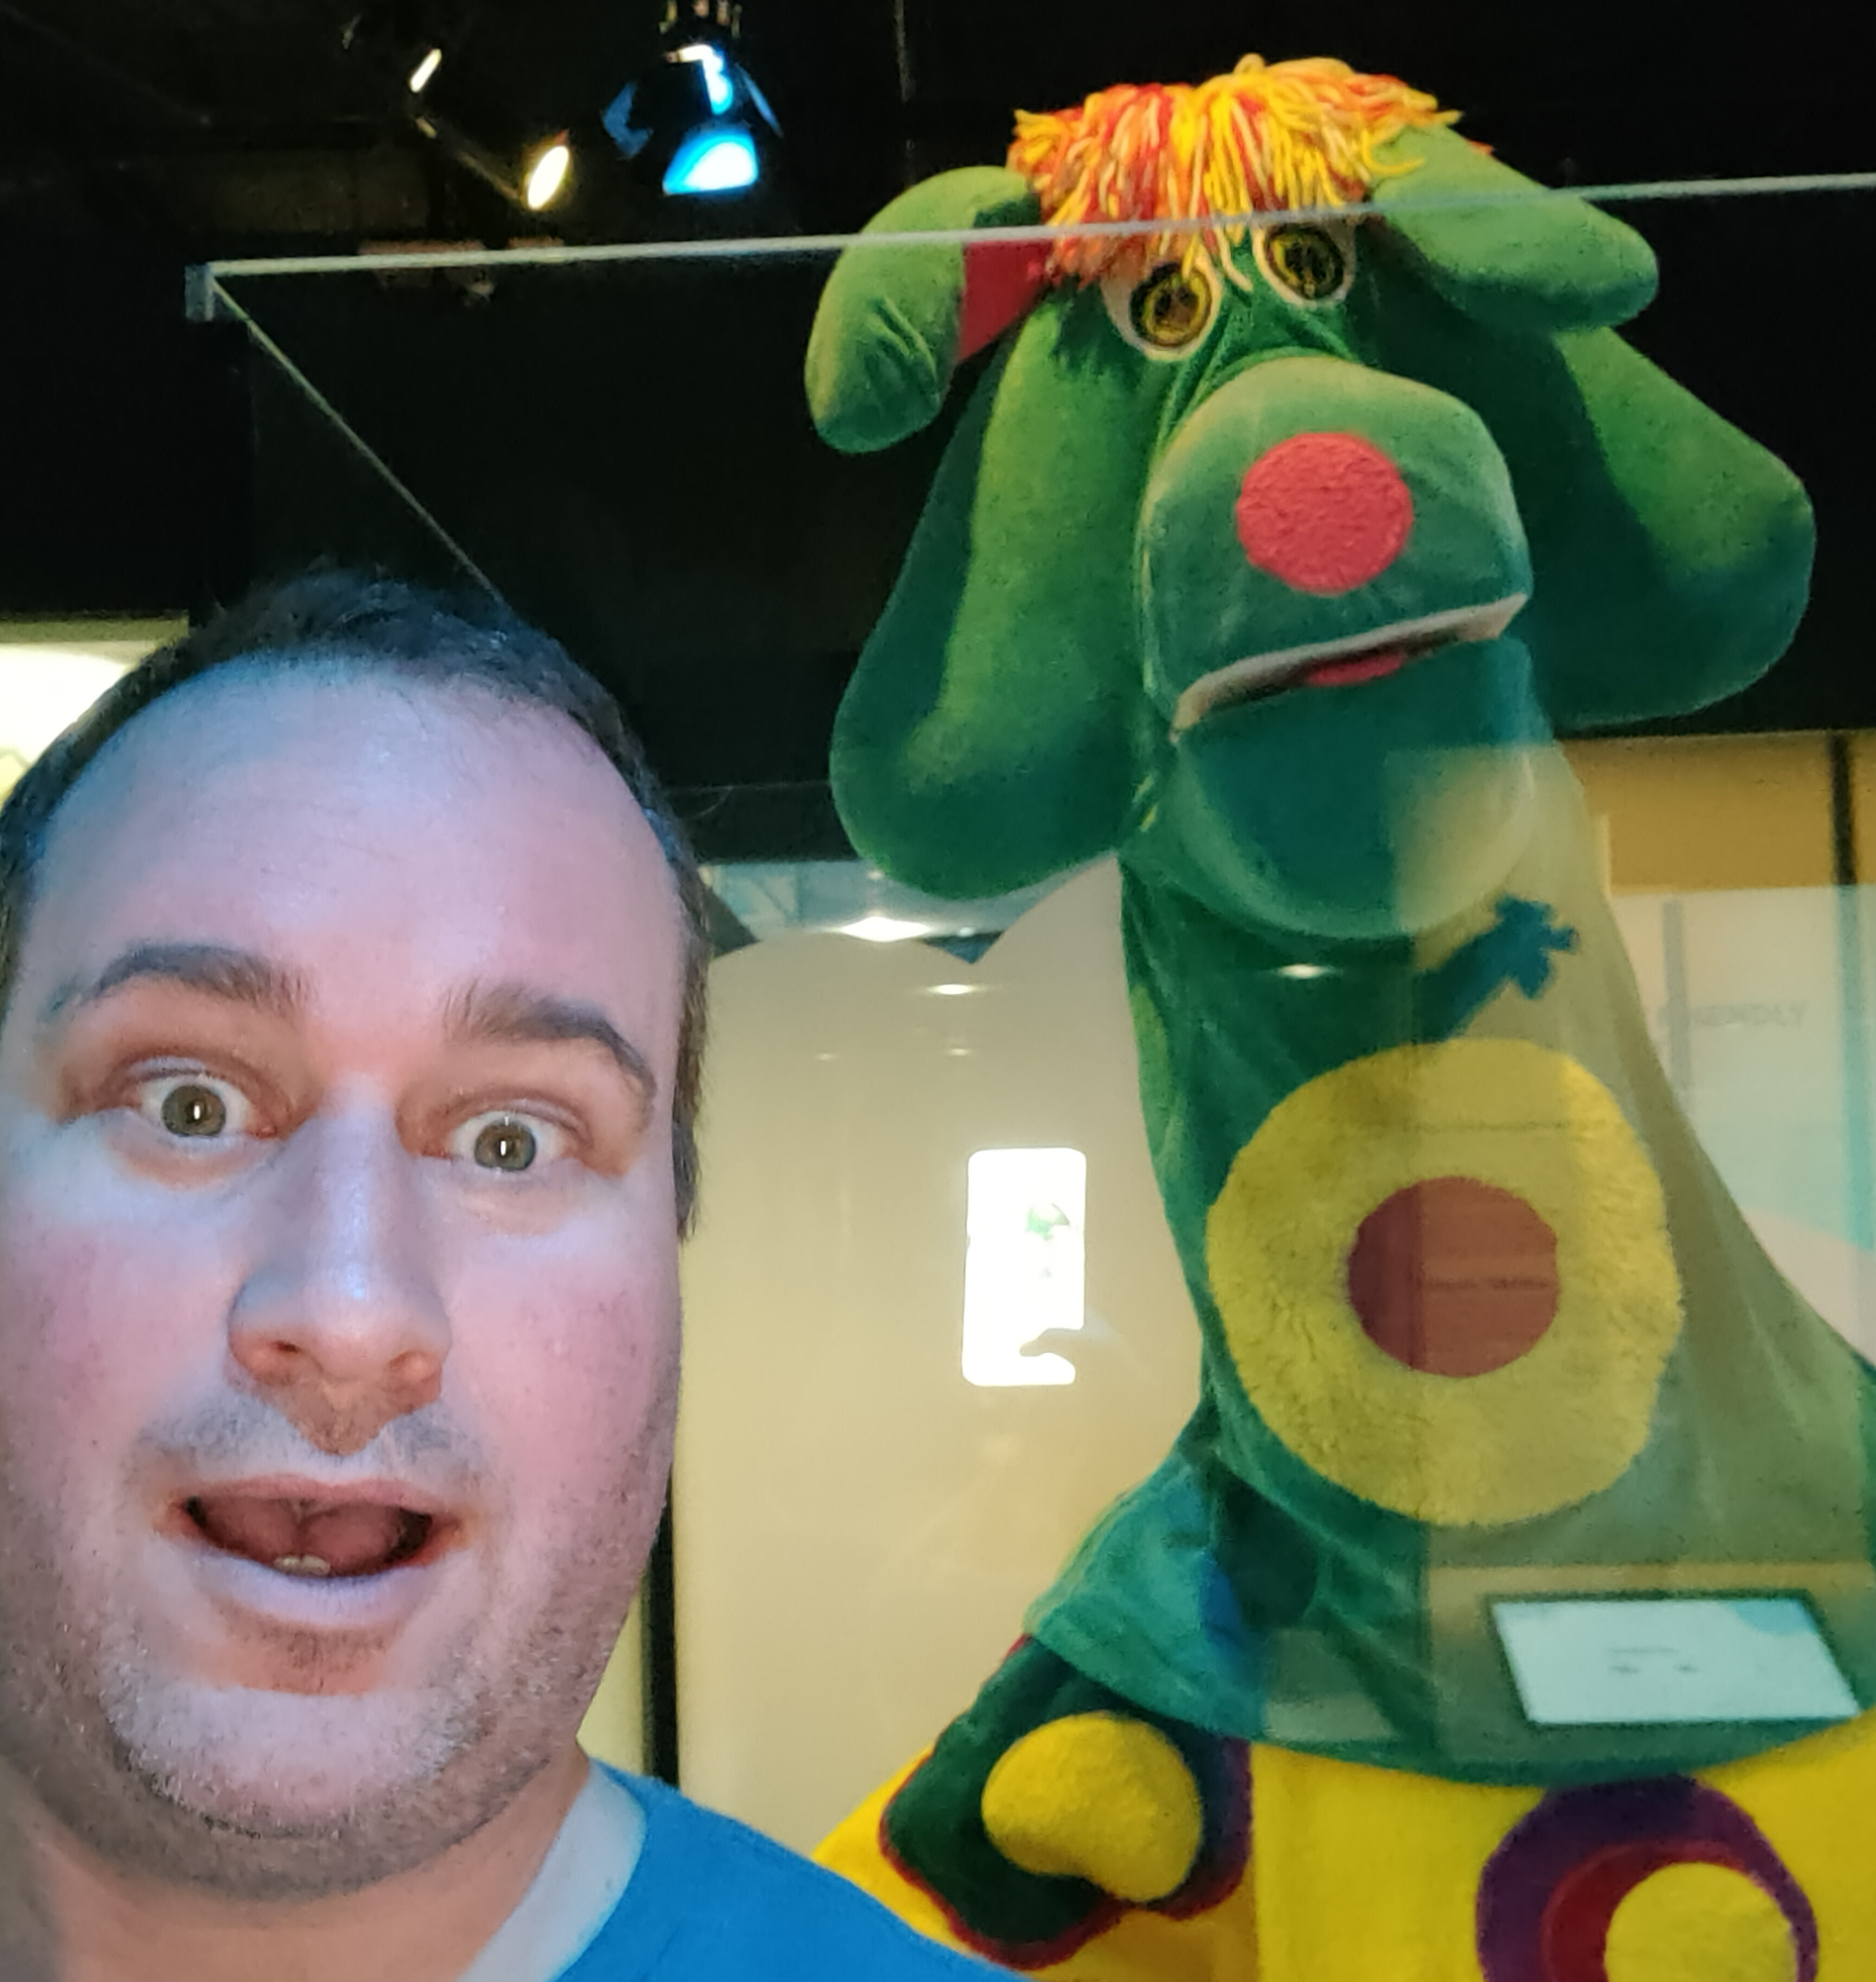
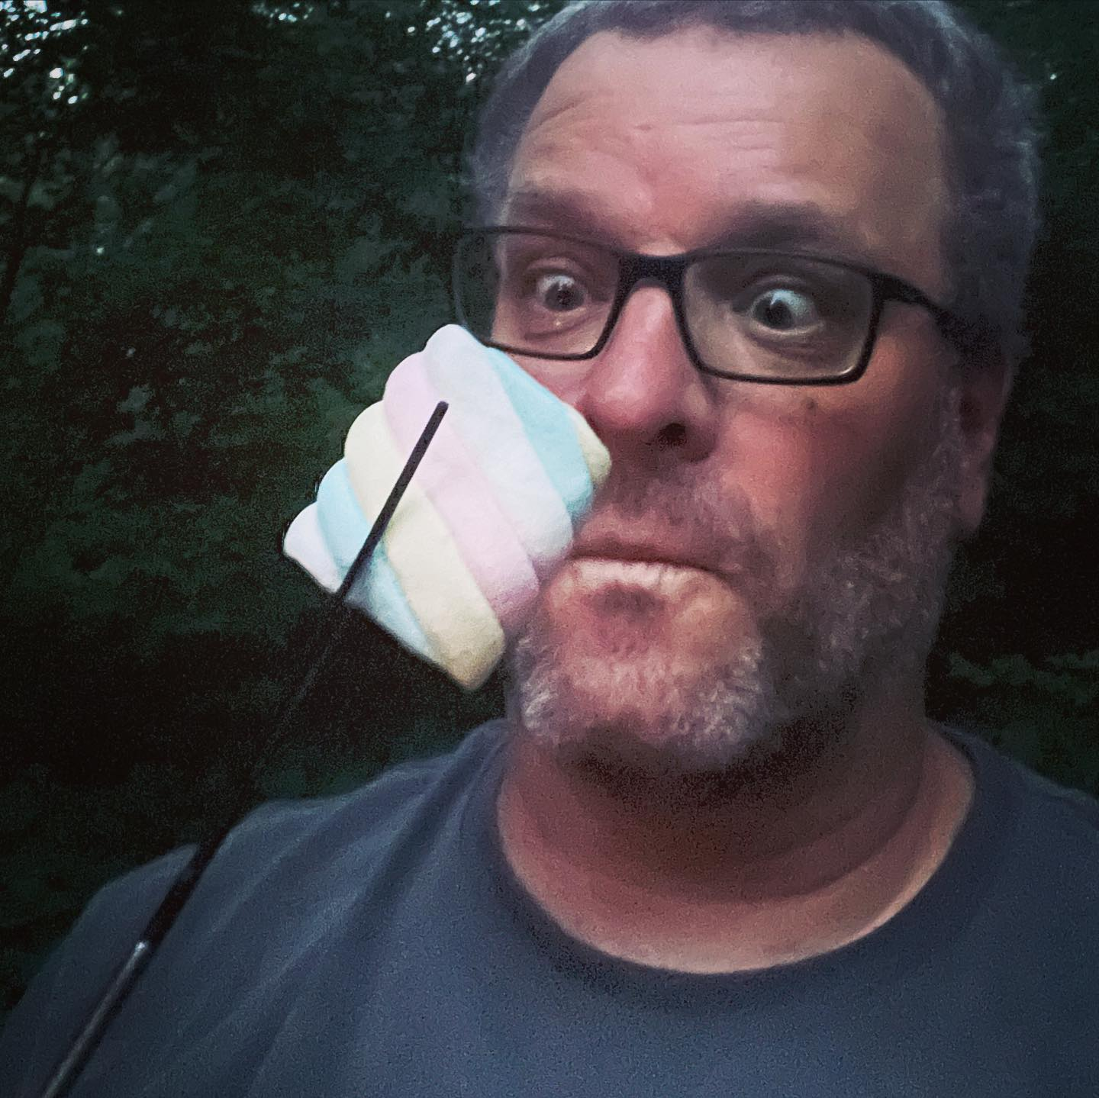
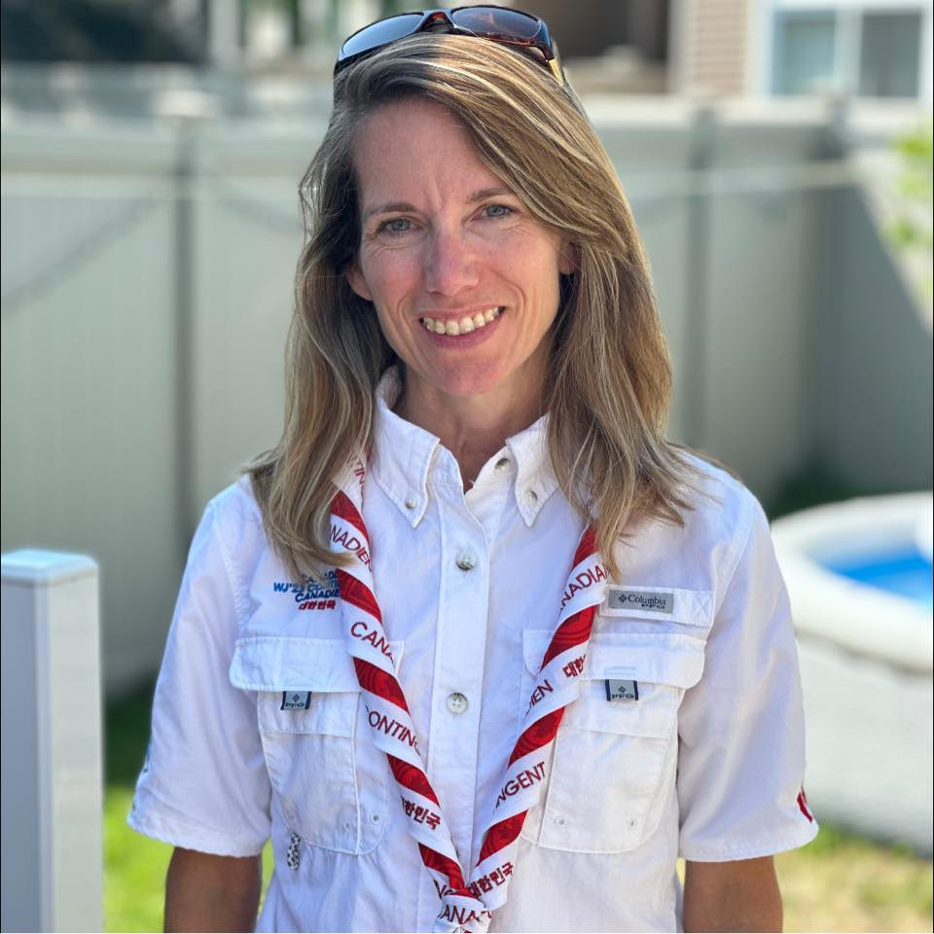
Meet our admin team
Jeff Reid
Marc Chamberland
Susie James
Event Chair
jeff.reid@scouts.ca
Deputy Chair
mchamberland@scouts.ca
Registrar & Treasurer
sjames@scouts.ca

Slide 4
Who’s Coming?
38 Colonies
397 Youth
145 Scouters
116 Parents
665 Voyageurians!
665 Voyageurants?!
665 Voyageurs!!!!

Slide 5
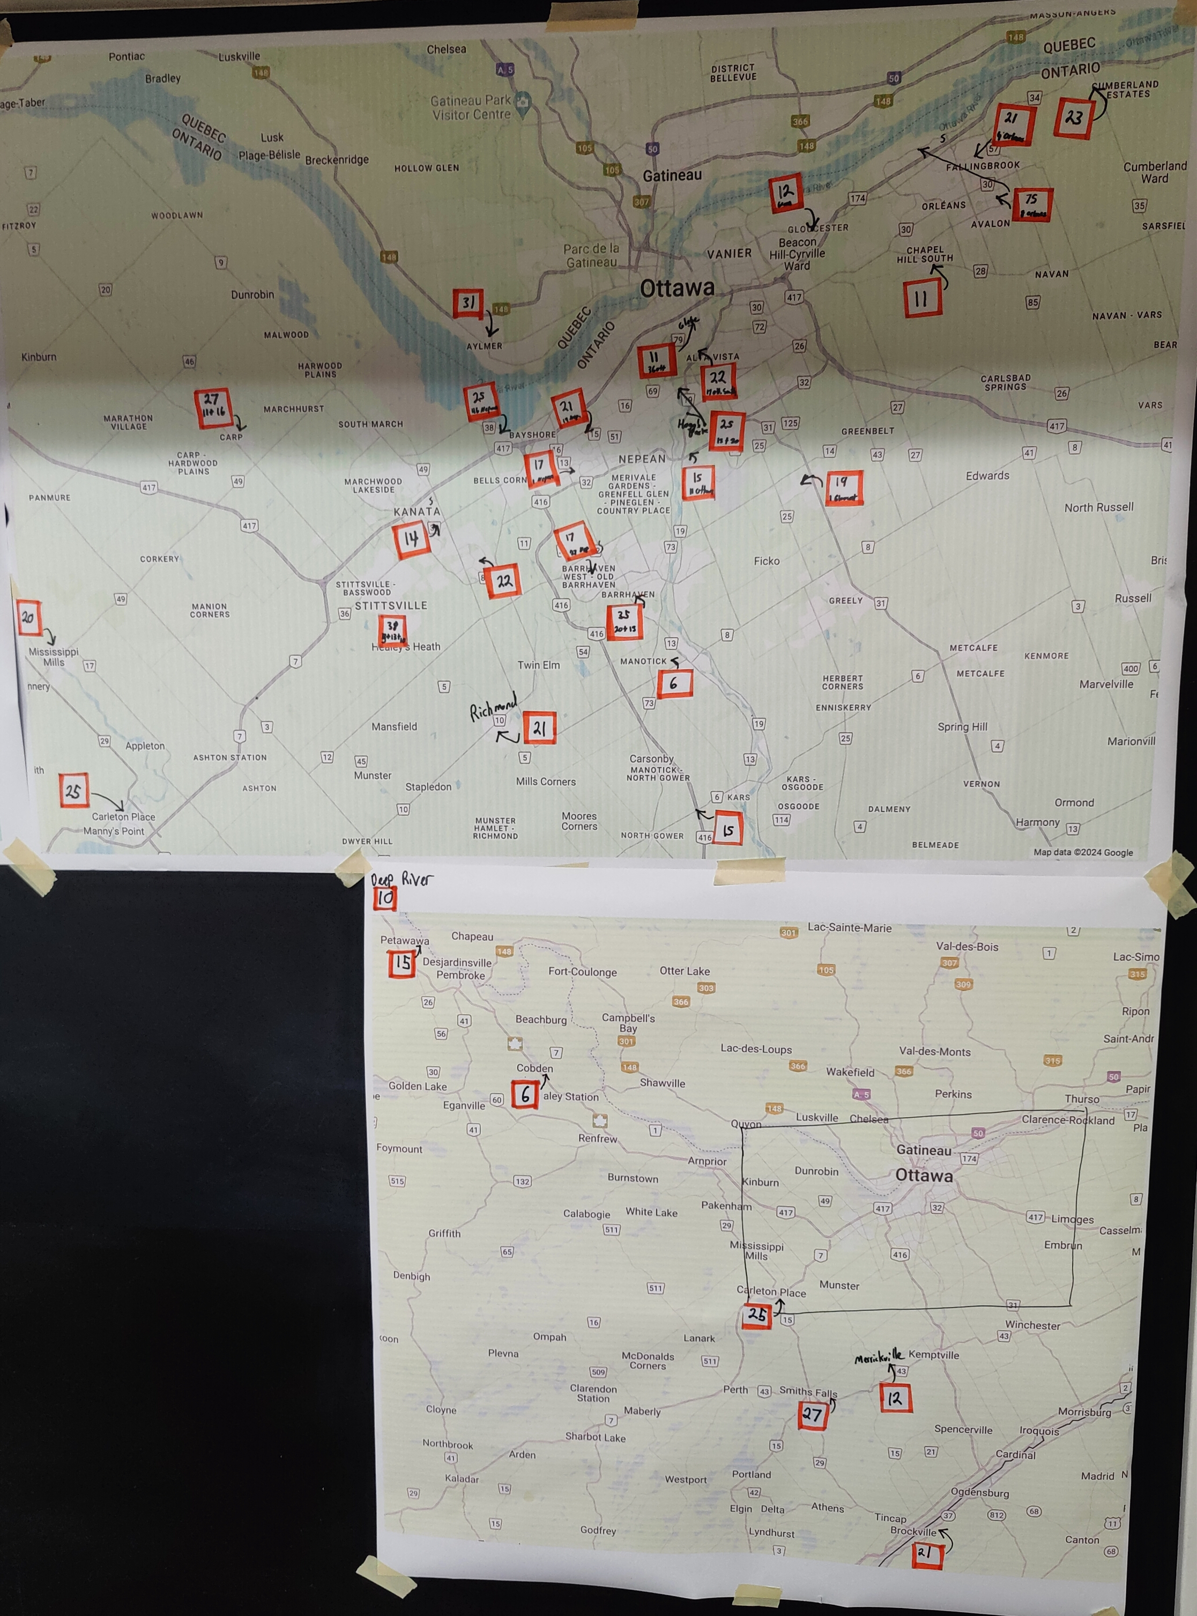
From where?

Slide 6
Timeline
6 Weeks
4 Weeks
2 Weeks
1 Week
June 1st
Start parent screening
Review Beaver Songbook
Attach ERP to event
Submit your AAF
Transport confirmation
Transportation guide
Info Session
Parent reminders
Event Guidebook
Show up on time!
HAVE FUN!

Slide 7
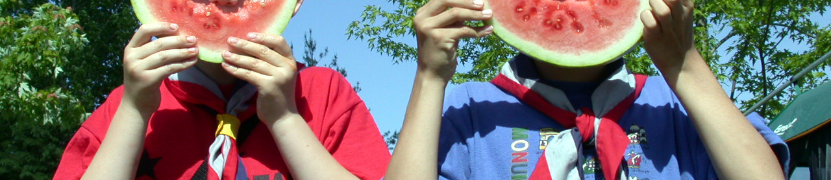
Screening
Parents & Guardians
Non-Scouting Youth
Signed Code of Conduct
Expectations discussion / role explained
Must be supervised during the day
Physical fitness form
Physical fitness form
Hold harmless agreement
Check with your GC!
Scouts Canada screening requirements:
https://www.scouts.ca/resources/bpp/procedures/volunteer-screening-procedure.html

Slide 8
AA-What?
We’ll have our event ERP ready for you in early May
Attach it to your event for AAF approval
It is on your Scouter-in-Charge to ensure your AAF is approved before June 1st

Slide 9
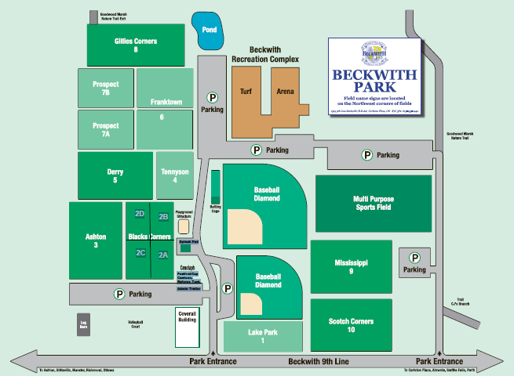
Facility
Rotation Area #1
Rotation Area #2
Virtual Campfire
Rotation Area #3
OOS / Event Parking

Slide 10
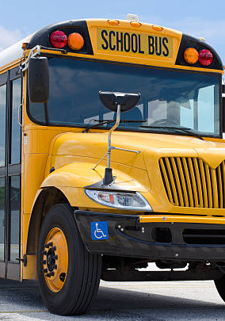
Transportation Update!
Buses will be timed for a 9:30am arrival at Beckwith.
Arrive early to check-in
Scouters are responsible for your Colony drop-offs (2 Scouters)
Buses will depart on time
We’ll have a “bus guide” for you!

Slide 11
Ottawa Hubs
Ottawa West
Ottawa South
Ottawa East
Ottawa Core
Quebec
Kanata Centrum + Wesley Clover
Carp, Stittsville, Kanata, Richmond, Nepean
8:40am Arrival
9:00am Departure
Fallowfield Park & Ride
Barrhaven, Kars, Manotick
8:30am Arrival
8:55am Departure
Place d’Orléans Park & Ride
Orleans, Gloucester, Cumberland
8:20am Arrival
8:40am Departure
Carleton University
Hogg’s Back, Airport, Glebe, Billings
8:30am Arrival
8:50am Departure
TDB
Aylmer
TBD

Slide 12
Voyageur Hubs
Voyageur West
Voyageur
South #1
Voyageur
South #2
Local
Deep River
Petawawa
Cobden
7:10am Arrival
7:30am Departure
Brockville
8:00am Arrival
8:20am Departure
Smith Falls (with Merrickville)
8:40am Arrival
9:00am Departure
Carleton Place (with Almonte)
9:00am Arrival
9:20am Departure

Slide 13
June 1st Timeline
7-8:30am
Bus hub arrivals, check-ins
9:30am
Attendees arrive, final check-ins
10:00am
Event opening
Our Song:
Herman the Worm!
10:30am
Activity rotations
12:00pm
Lunch
12:45pm
Activity rotations
2:00pm
Virtual campfire (nation-wide)
3:15pm
Activity rotations
4:00pm
Departures

Slide 14
Activity Rotations
Remember!
This is a birthday bash!
Activities will be designed for multiple Beavers to complete together
Colonies are attending as a Colony… their Scouters can help with running some activities
Guides to be provided in advance
Many activities will require minimal supervision of OOS, depending on risk level
Registrar will create 27 “groups”
  Assigning 9 to each rotation area (one per activity)
  Average of 16-20 beavers per group
Colonies will have a chance to complete each activity, if they wish
  Scouters know their Beavers, they can take breaks or skip an activity
20 minute rotations, 5 mins travel

Slide 15
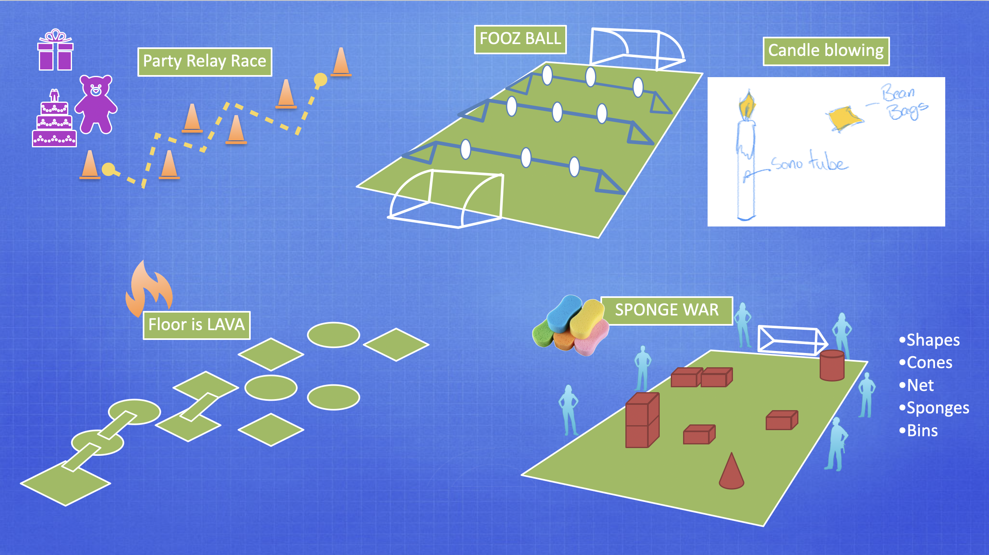
Did someone say… activities?

Slide 16

At the end of the day…. Swag!
Note: Unfortunately bucket hats are not available

Slide 17


Slide 18
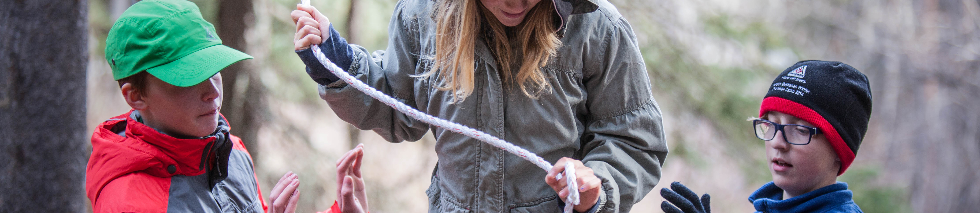
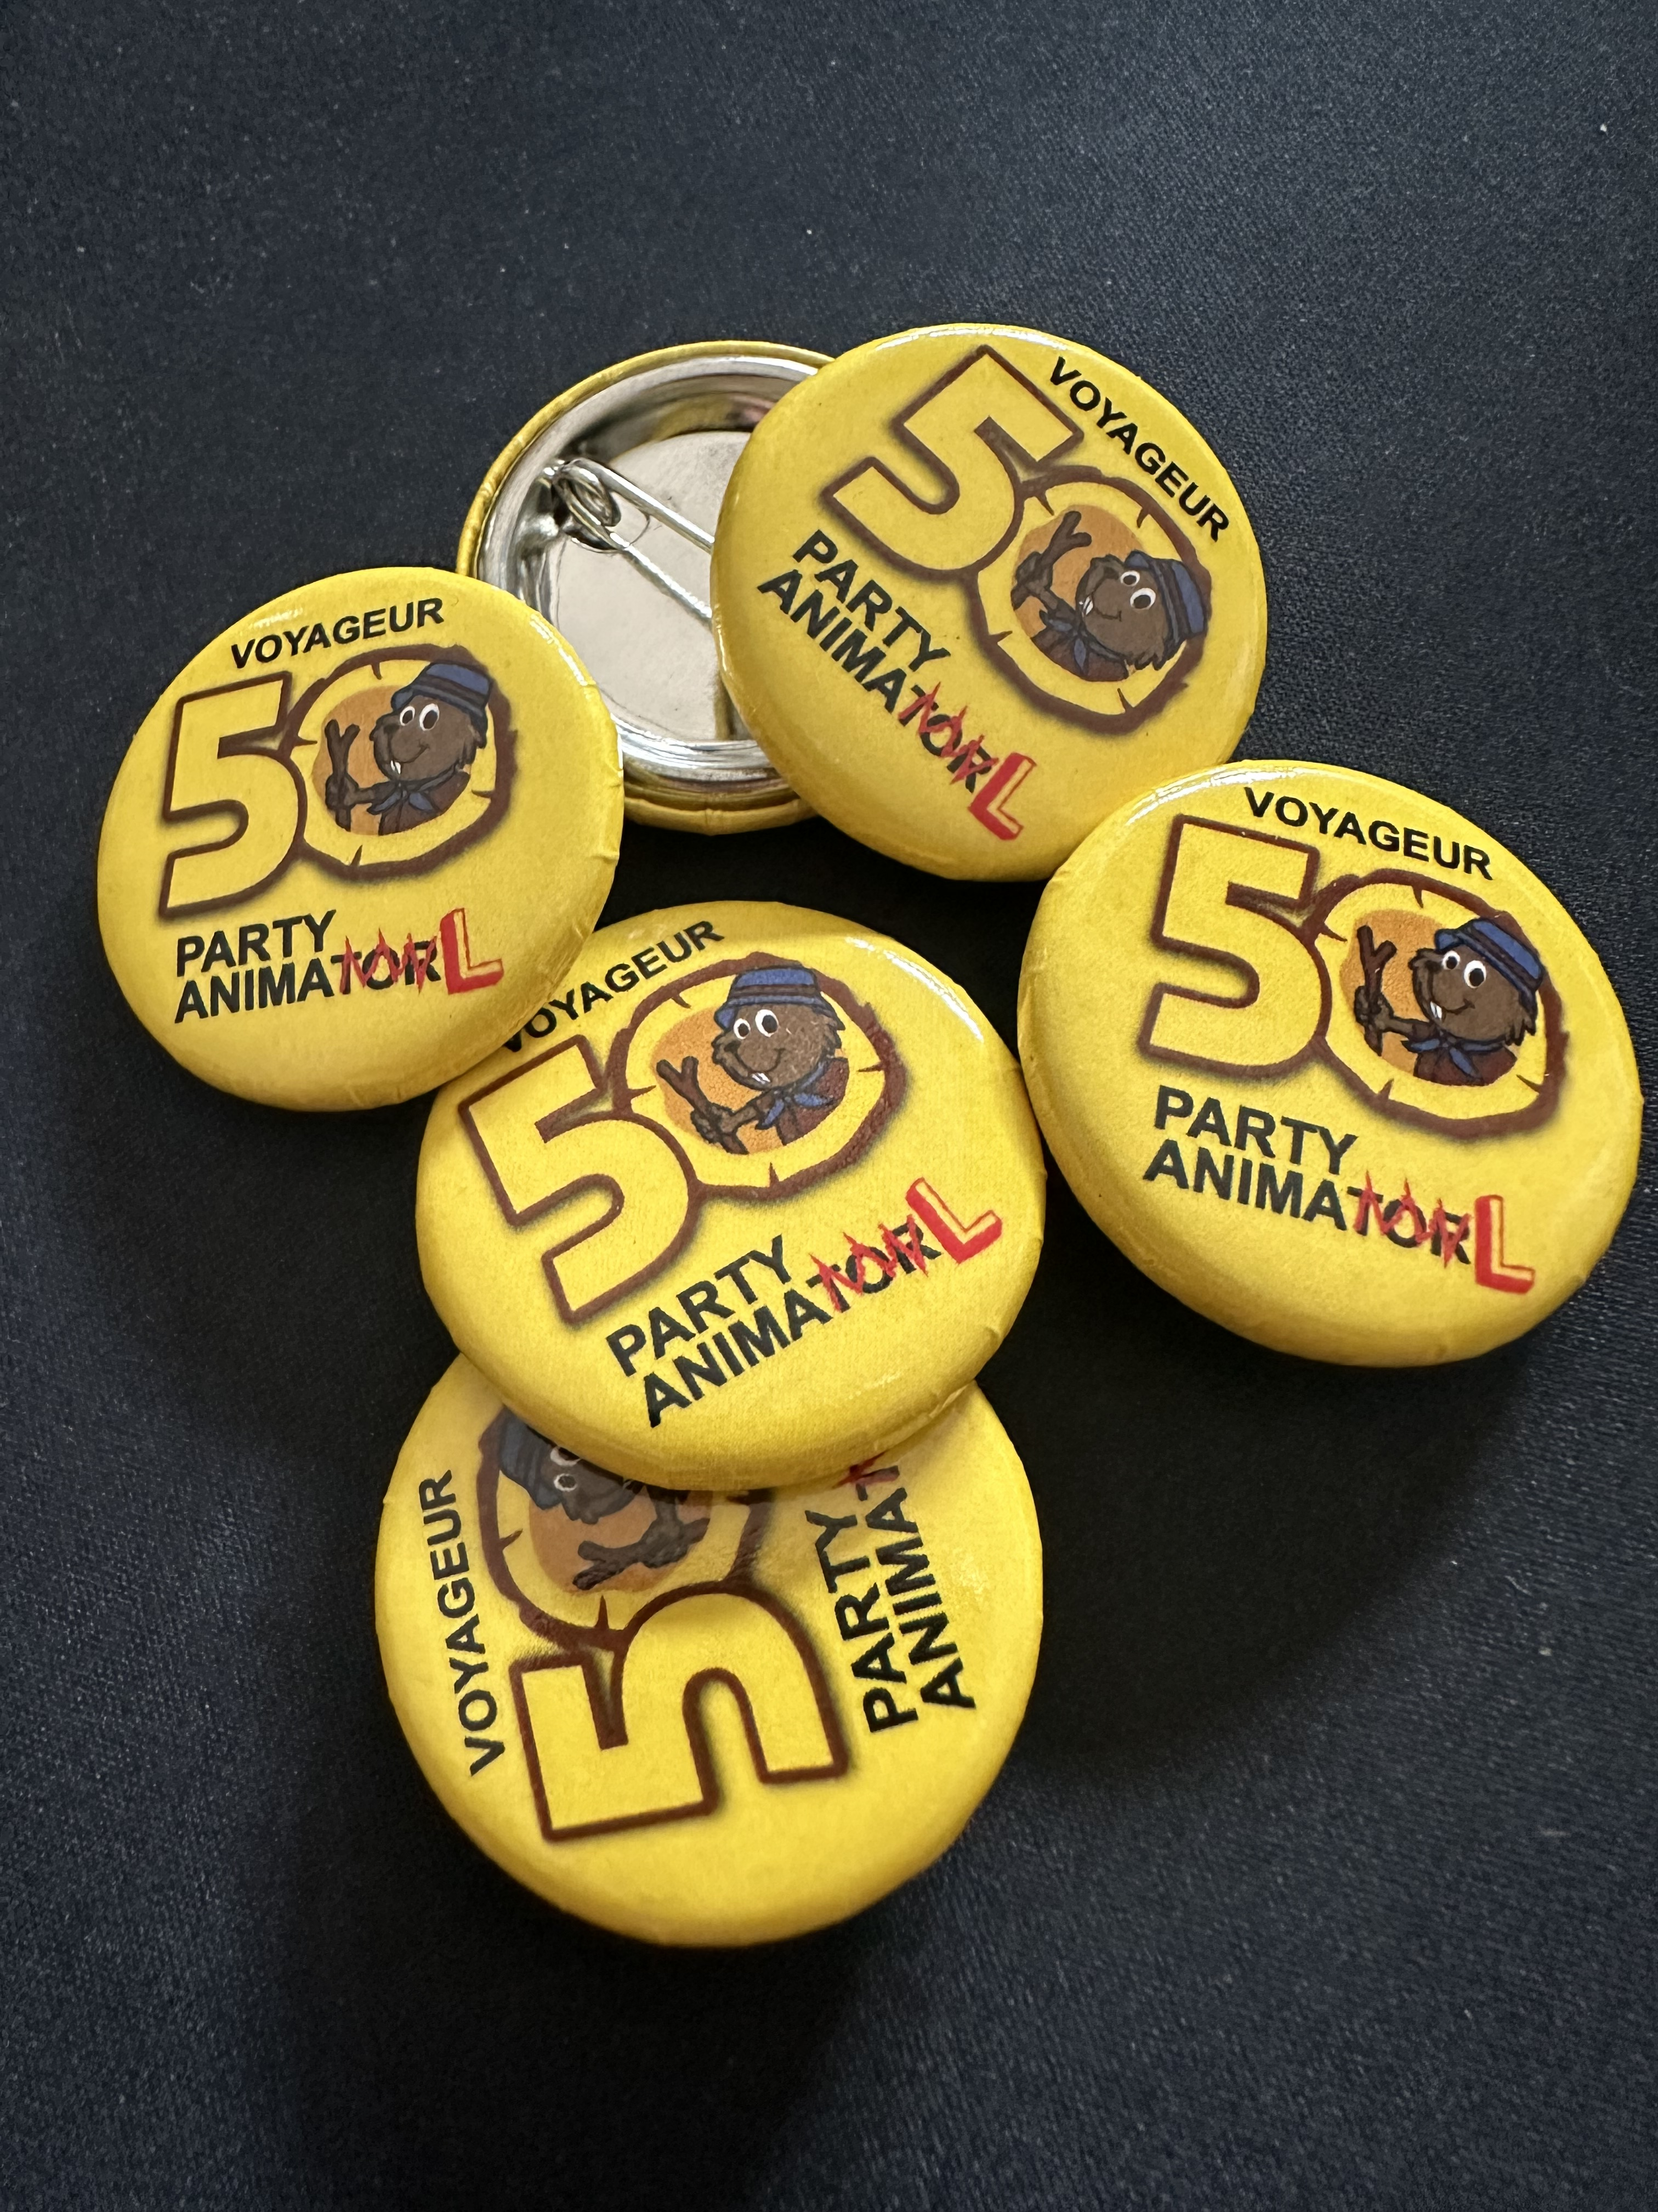
We Need OOS!
Adult OOS Requirements
Youth OOS Requirements
Valid Scouts Canada member
Completed CoC
Valid PRC
Valid Scouts Canada member
Completed CoC
Role explanation
Reduced cost (no t-shirt): $23 / person

Slide 19
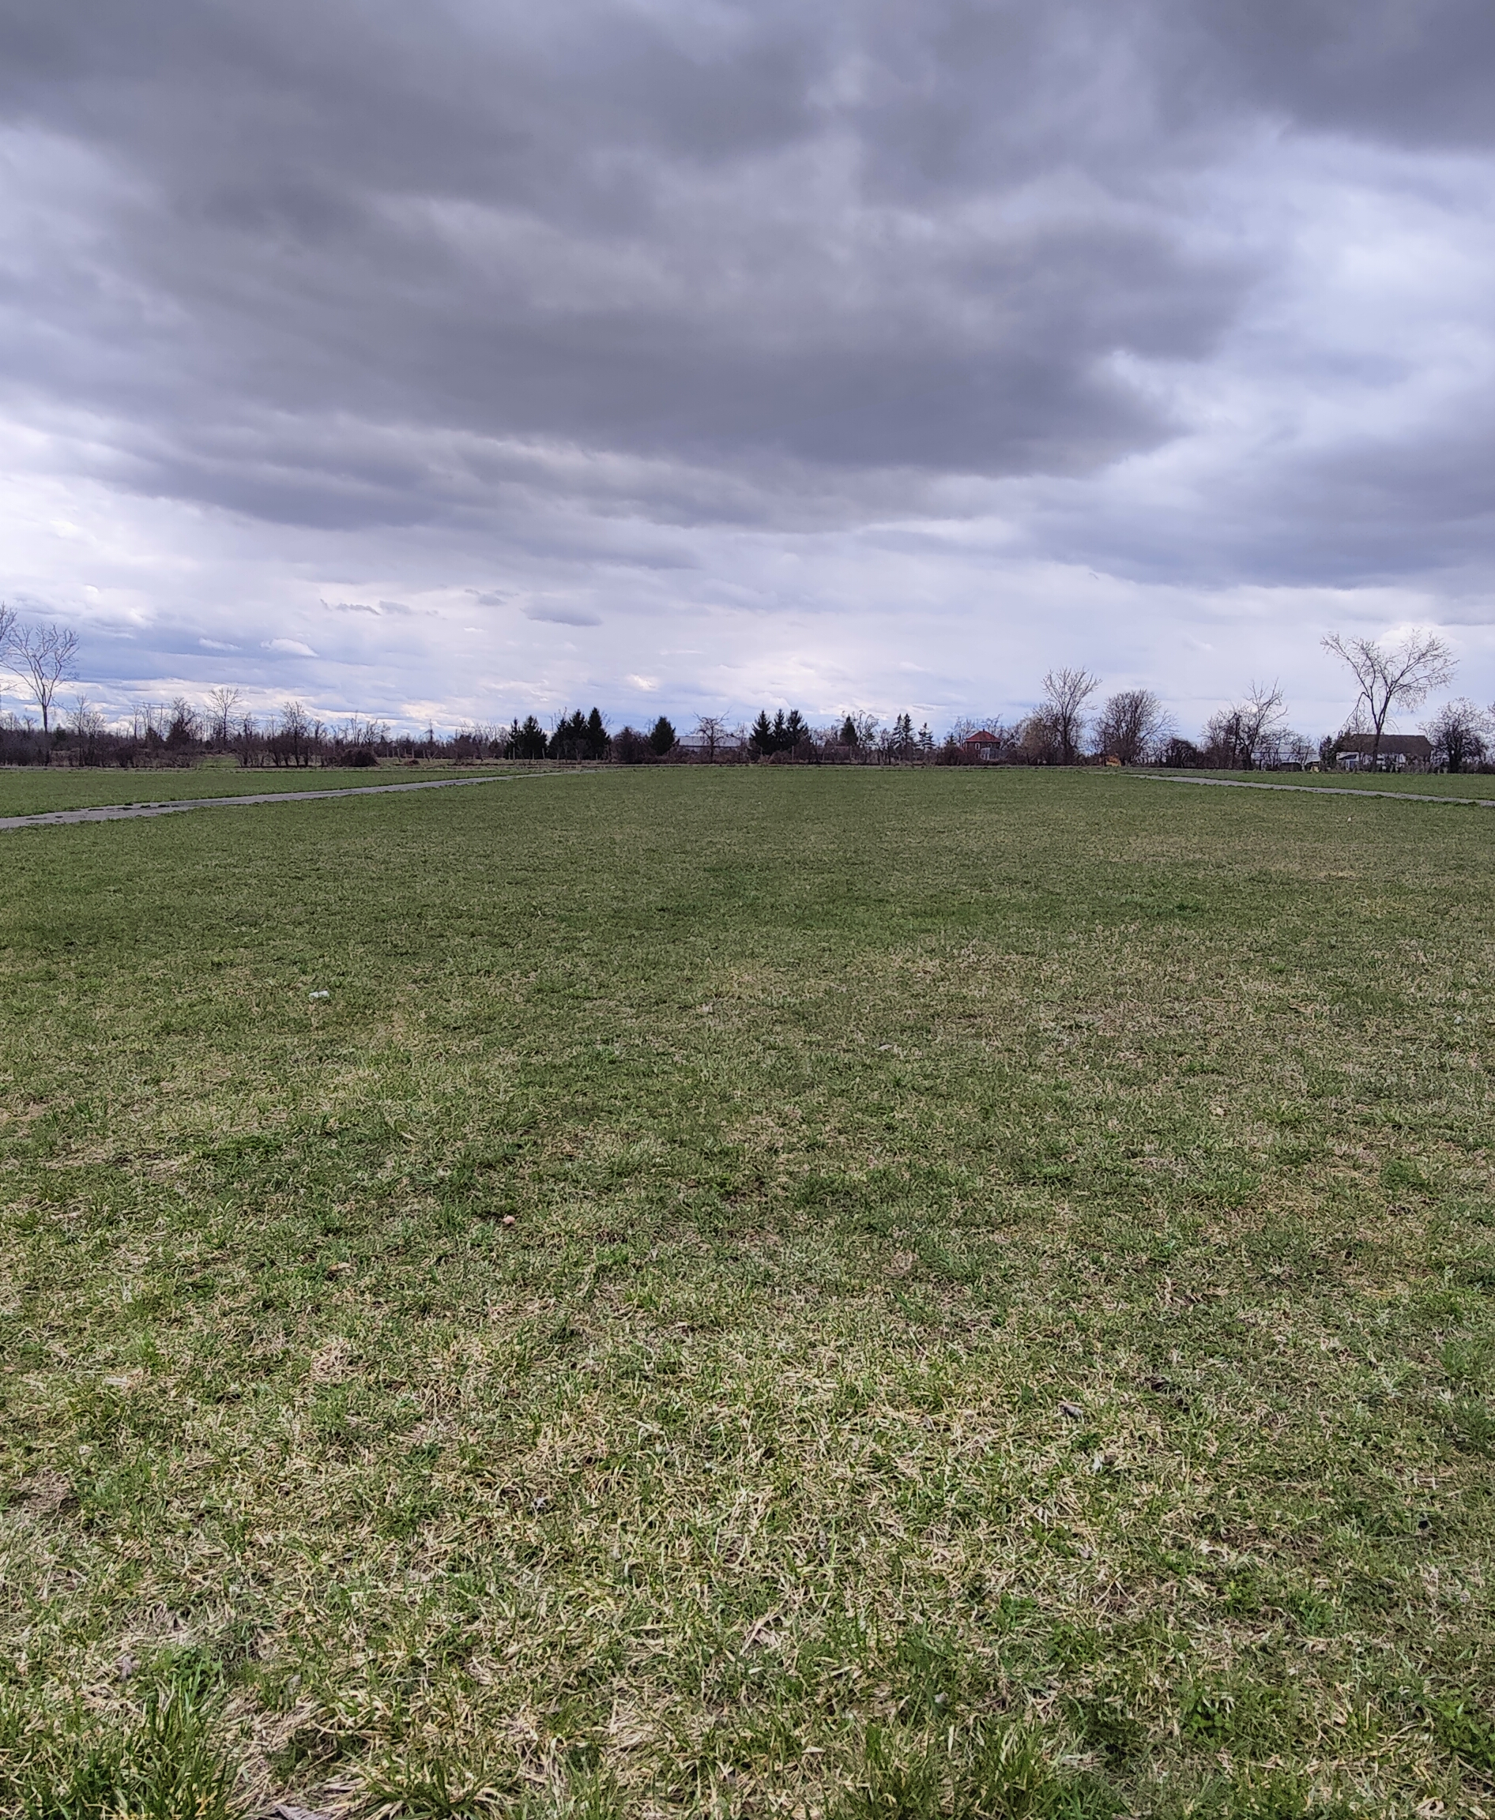
We Need OOS!
Please talk with your Senior Sections; we’ll be updating our OOS page this week.
Camping? SURE! If your senior section wants to camp around the Beaver 50th, we’d love to have them.

Slide 20
Any Questions?
(Submit them on the website if you think of them later)

Slide 21
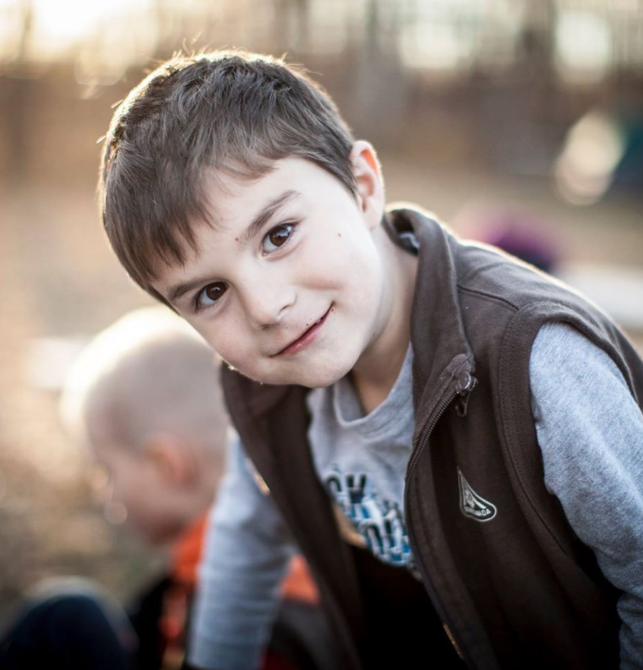
Resources!
Voyageur Beaver 50th Website!
https://www.beaver50th.ca/
Beaver 50th Newsletter
Sent out every 2 weeks to registered Colonies.
Contact Jeff Reid (jeff.reid@scouts.ca) anytime!

