Slide 1

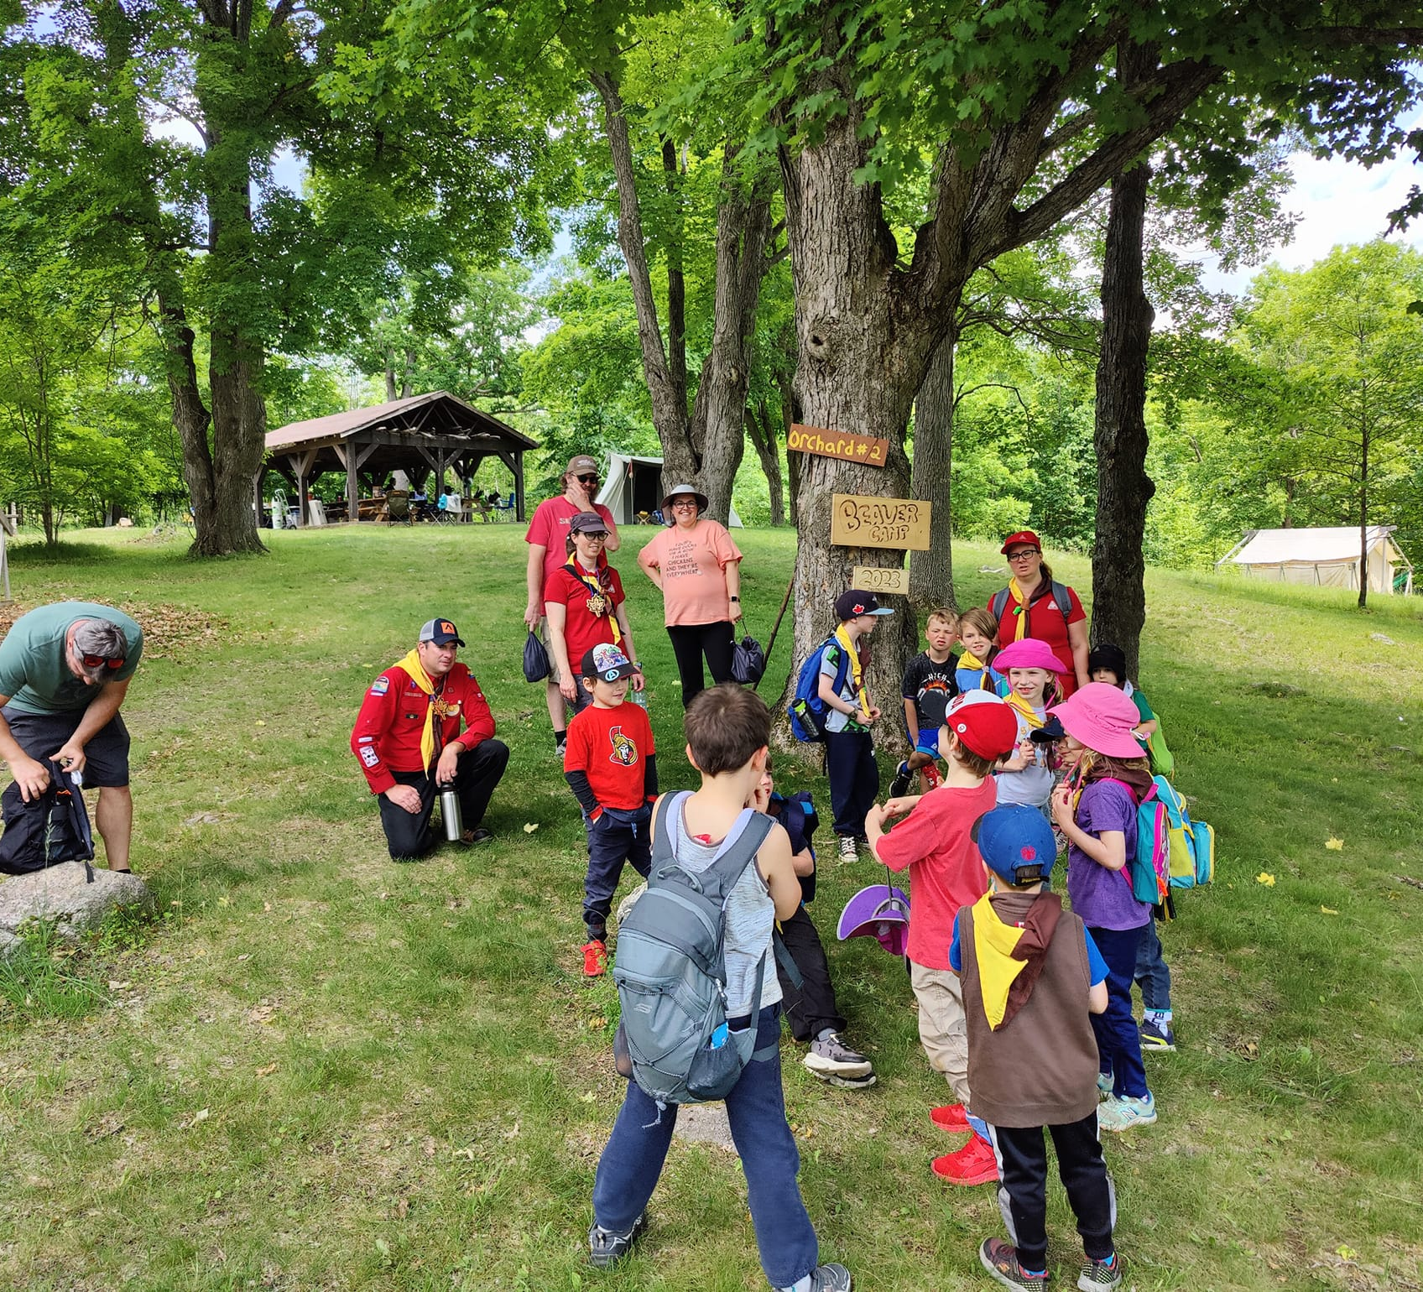
Voyageur Council Birthday Bonanza
Scouter Information Session
February 25, 2024

Slide 2
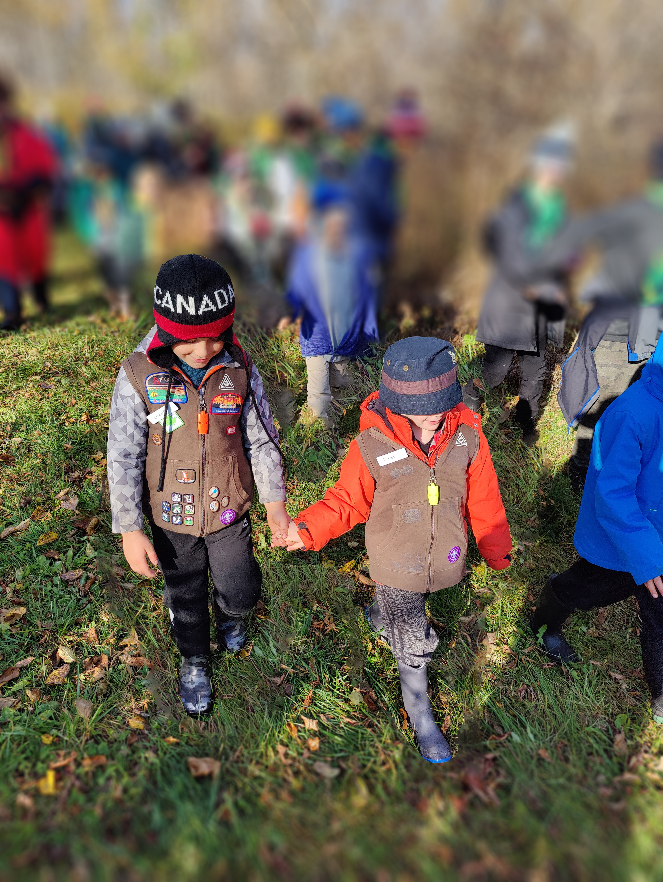
Agenda
Welcome / Introductions
What is this 50th about?
Voyageur’s party for Beavers
Timelines for the event
Registration Process
What’s next?
Q&A

Slide 3
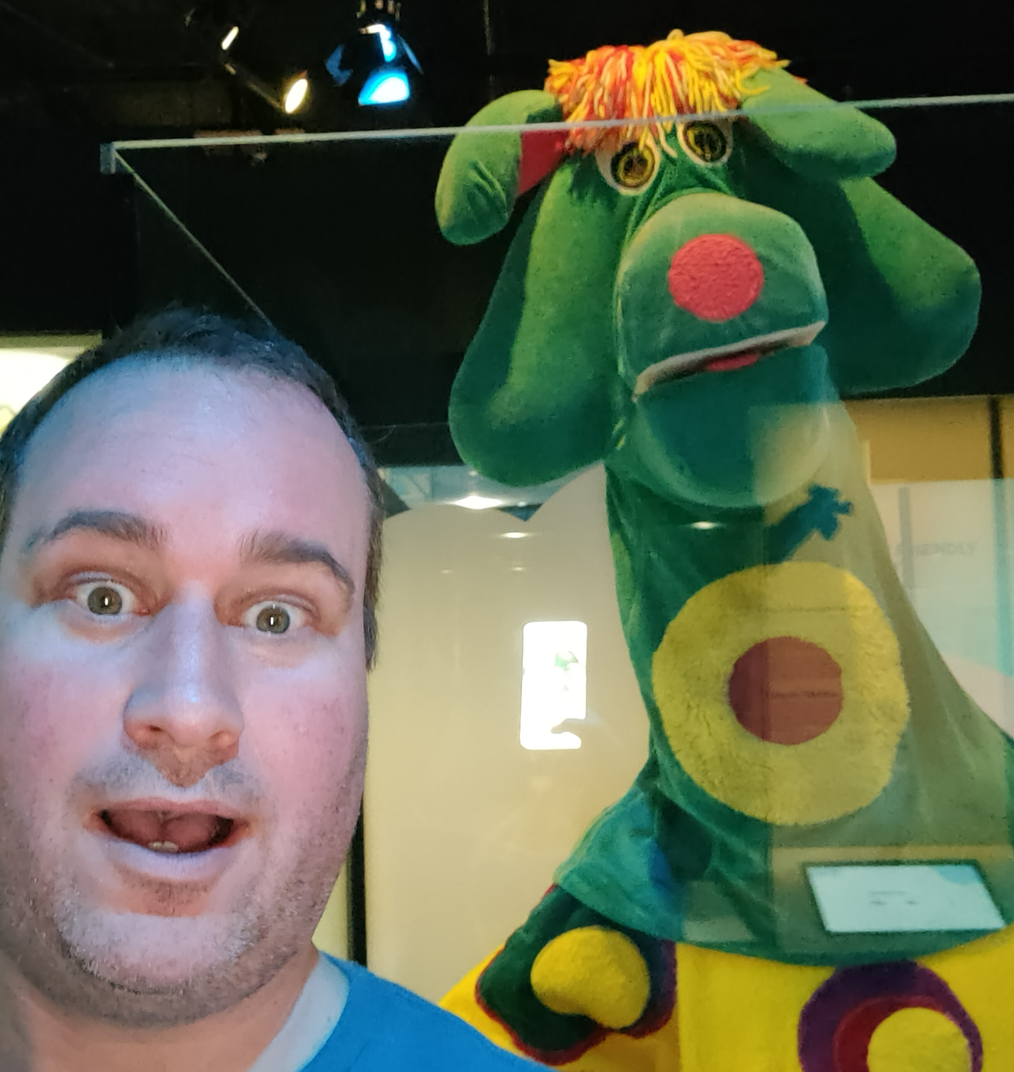
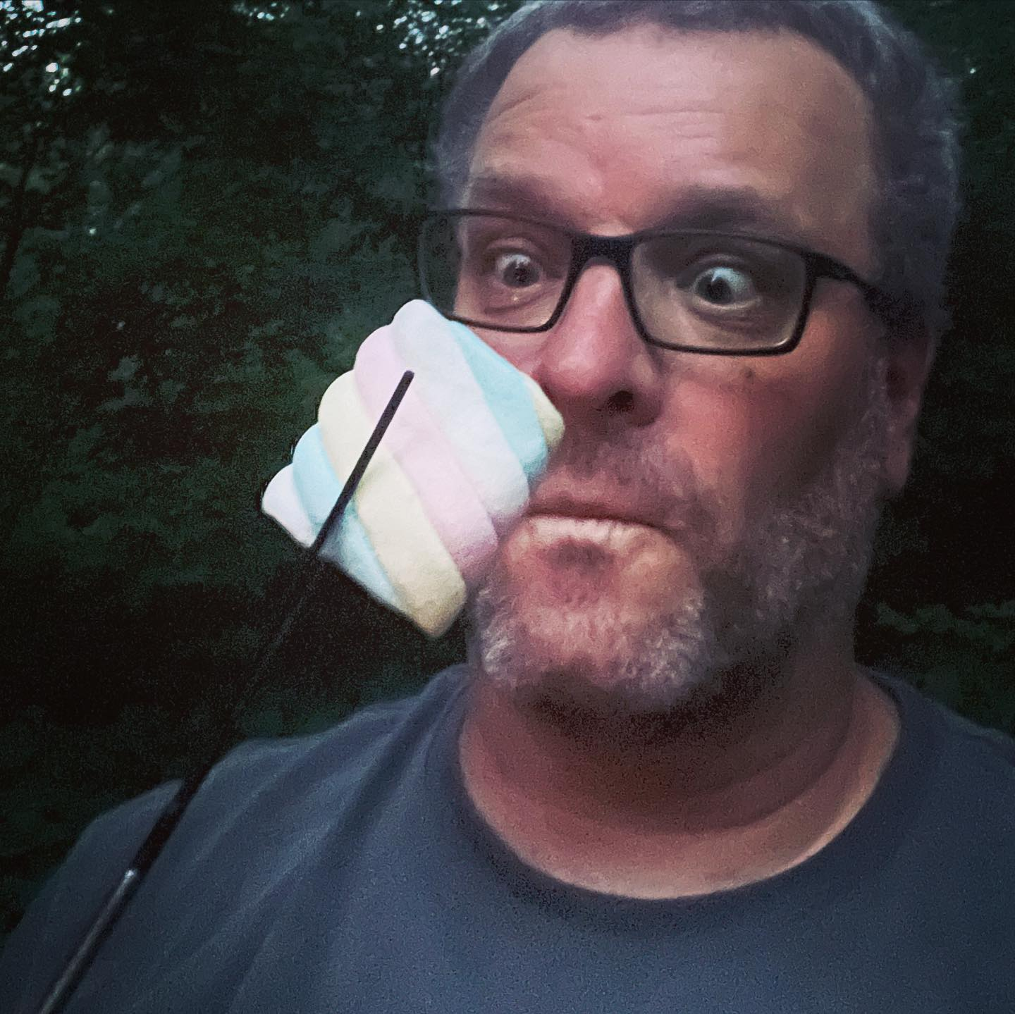
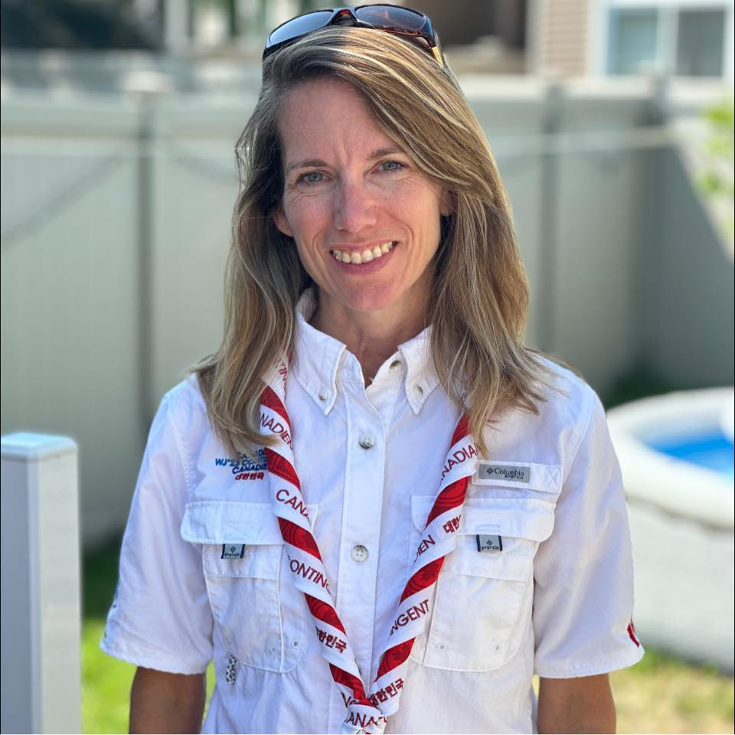
Meet our admin team
Jeff Reid
Marc Chamberland
Susie James
Event Chair
jeff.reid@scouts.ca
Deputy Chair
mchamberland@scouts.ca
Registrar
sjames@scouts.ca

Slide 4
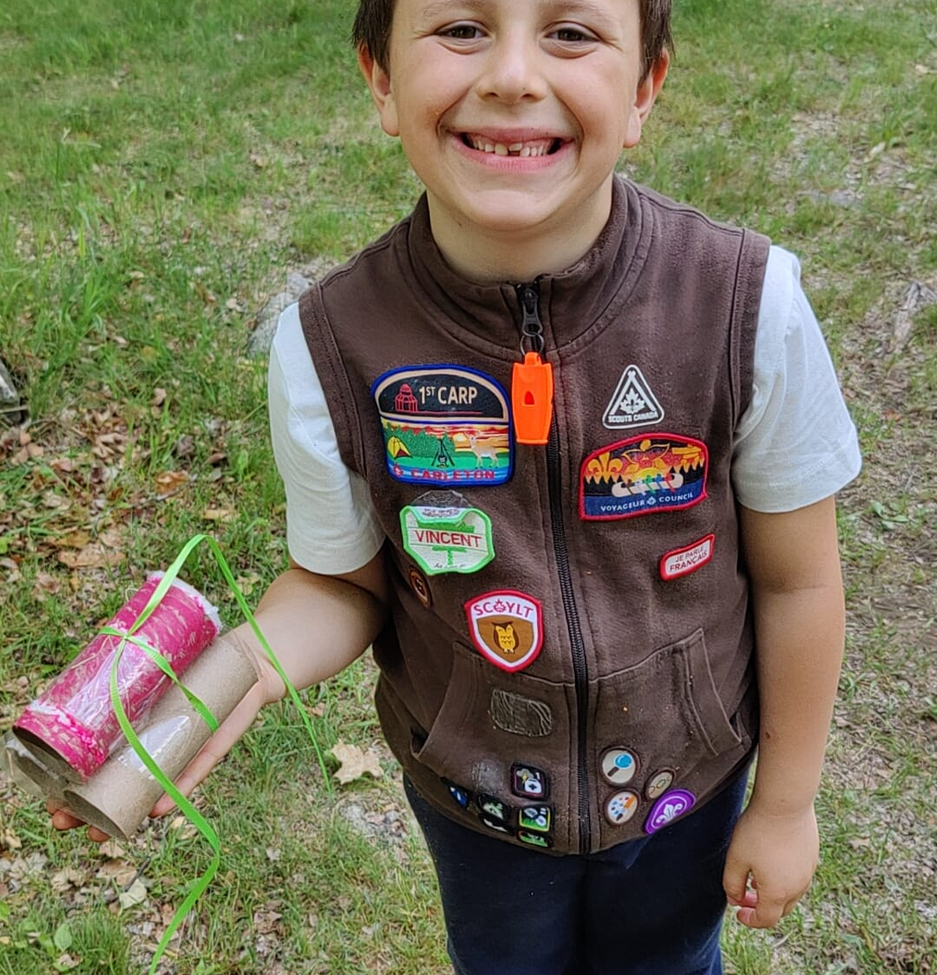
Beaver 50-what?
2024 marks 50 years since the Beaver program started in Canada… so we’re holding a nation-wide party on June 1st!
Each Council will run their own event
Format is a 10am-4pm event
A one-hour national “virtual campfire” held across every region
Voyageur has over 1200 Beavers, and 375 Scouters

Slide 5
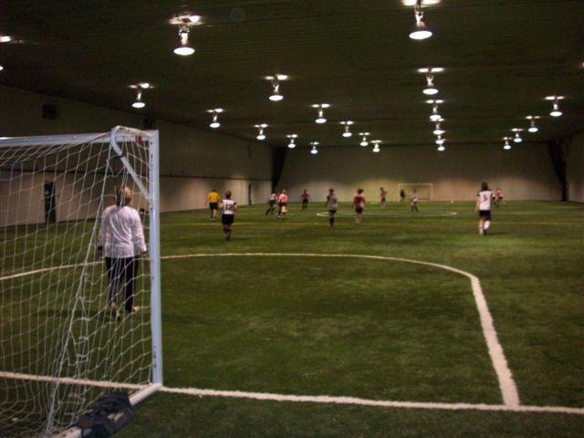
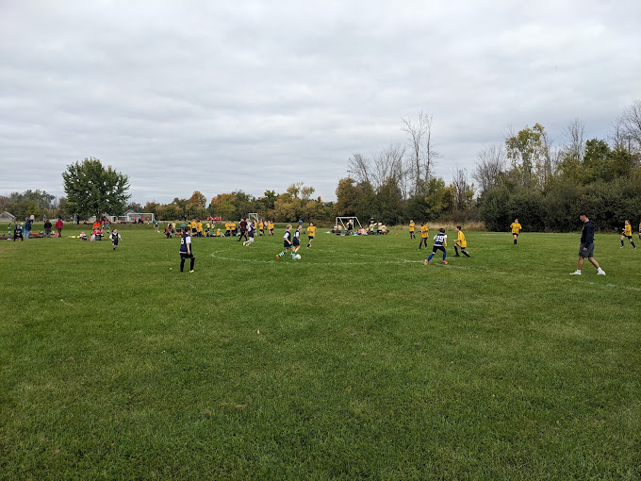
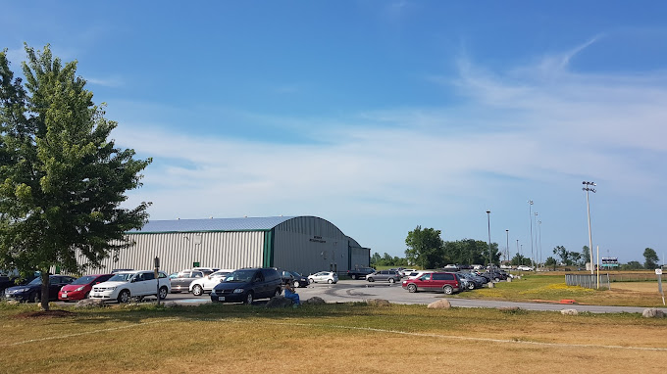
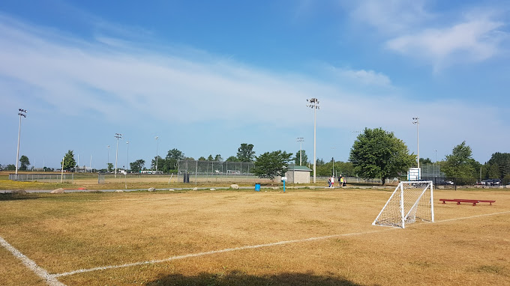
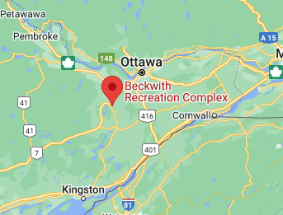
Where?
Beckwith Recreation Complex
1319 9th Beckwith Line
Carleton Place

Slide 6
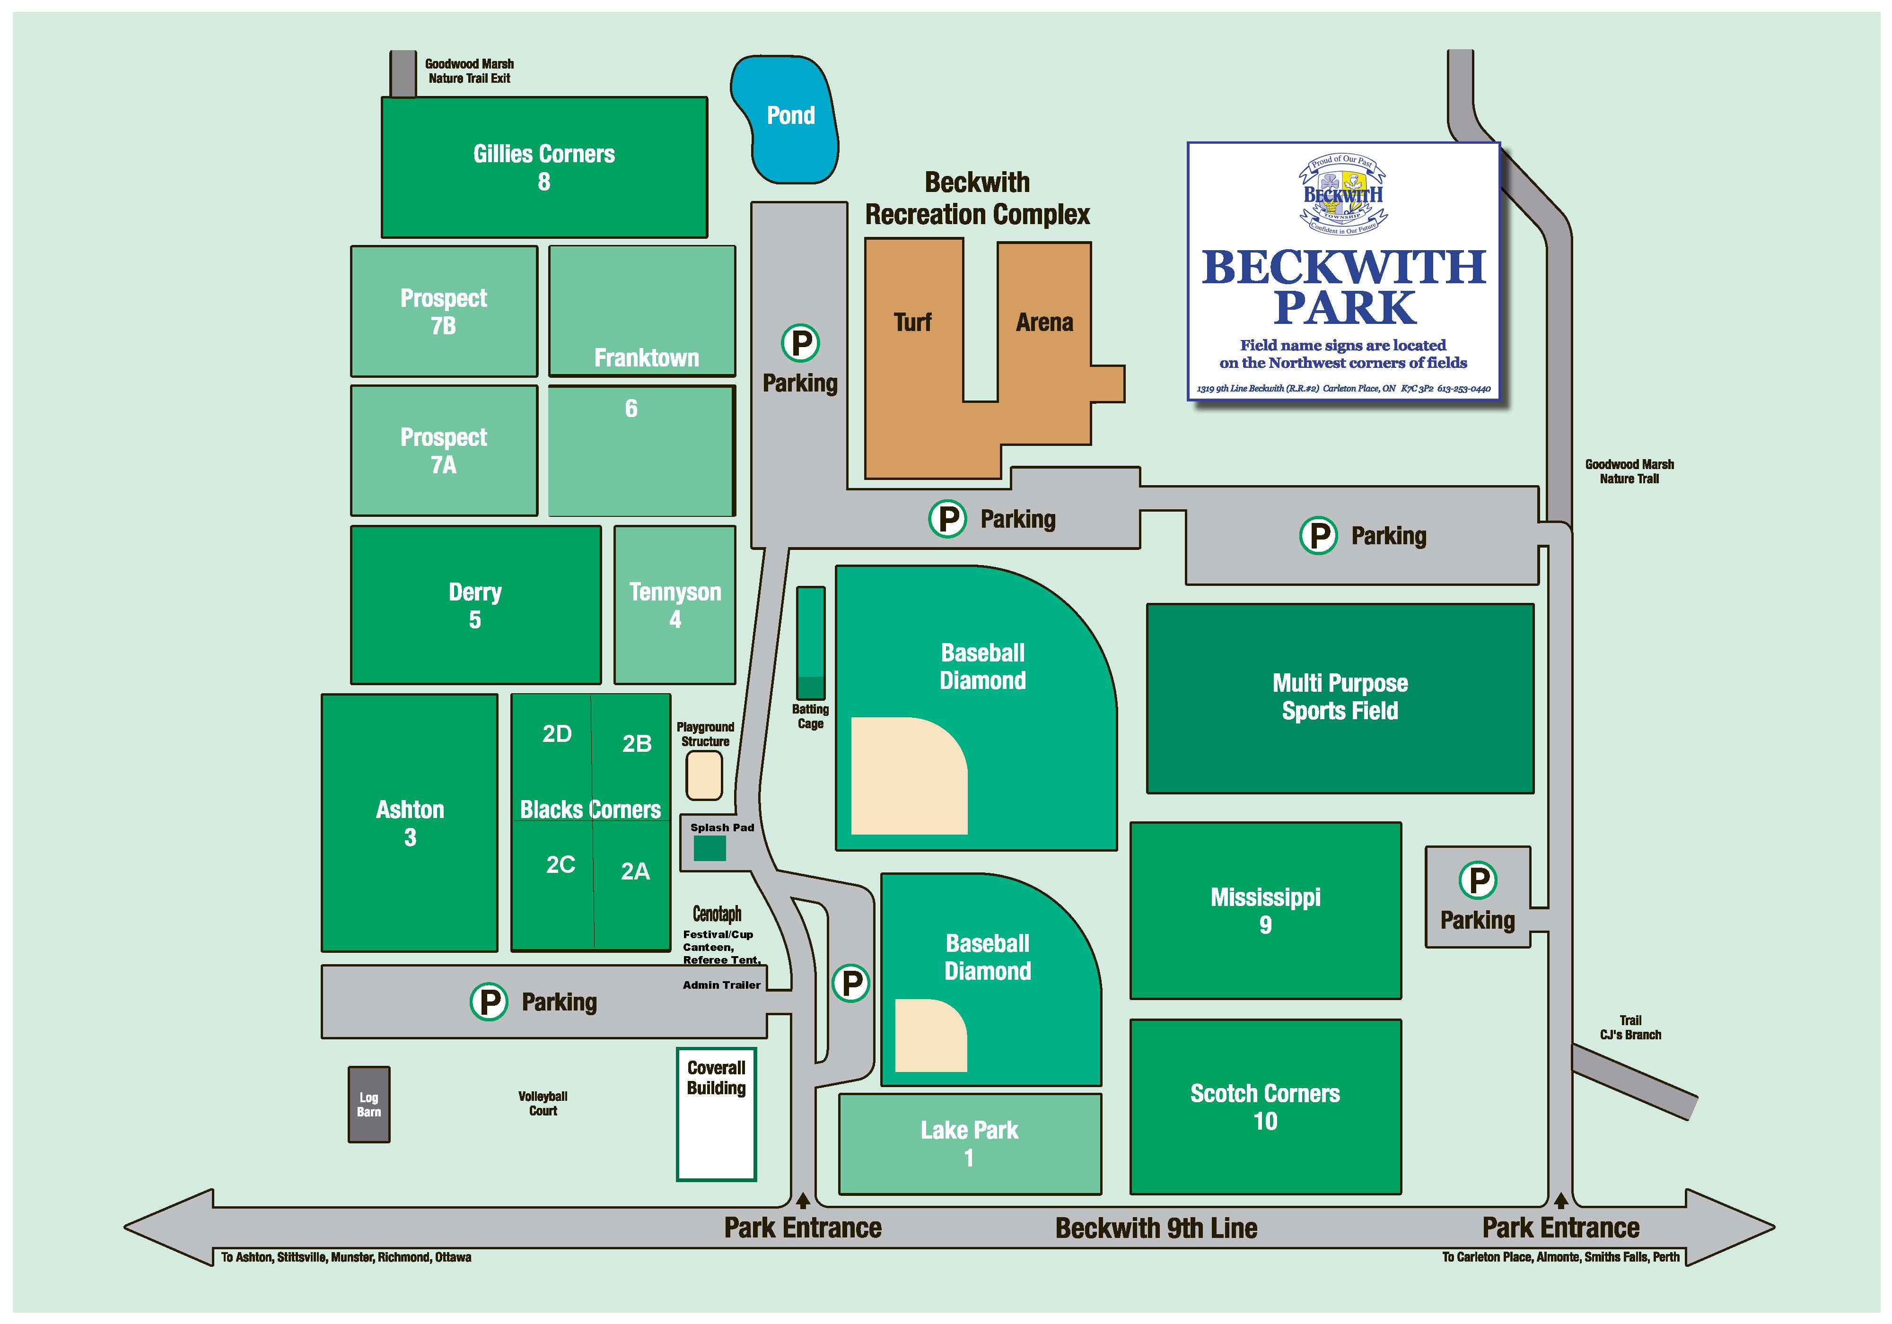
Where?

Slide 7
June 1st Timeline
7-8:30am
Bus hub arrivals, check-ins
9:30am
Attendees arrive, final check-ins
10:00am
Event opening
10:30am
Activity rotations
12:00pm
Lunch
12:45pm
Activity rotations
2:00pm
Virtual campfire (nation-wide)
3:00pm
Departures

Slide 8
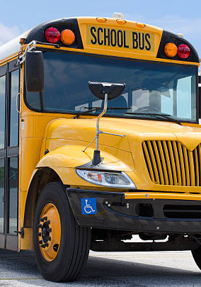
Transportation... hubs?
That’s right! We will bus everyone to the event from different hubs around Voyageur.
Why?
Minimizing traffic around the site, and check-in times
For those further away from the site, each parent won’t need to travel
The fun begins on the bus!

Slide 9
Transportation... hubs?
Where?
Locations to be determined, once registration is completed
When?
Check-in time will be set based on distance to Beckwith
Departure from the 50th will be based on distance; furthest to travel will leave first

Slide 10
Activities?
Bowling
Can Knockdown
Face painting
Water gun targets
Lollipop Game
Rubber Duck Match
Go fish
Micromachine races
Dino dig
Photo Booth
Catapult frogs
Soda Bottle Toss
Cornhole
Birthday Card
Water Transport Challenge
Compass activity
Time capsule
Fire Lighting station
Balloon pops
Spider Web

Slide 11
Nation-wide Virtual Campfire!
To celebrate this momentous event, we’re planning for a national virtual “campfire” with all councils across Canada!
Meet Beavers from across Canada, as they broadcast from their event
Nation-wide sing along of our favourite campfire songs
US, singing songs to Beavers across Canada

Slide 12
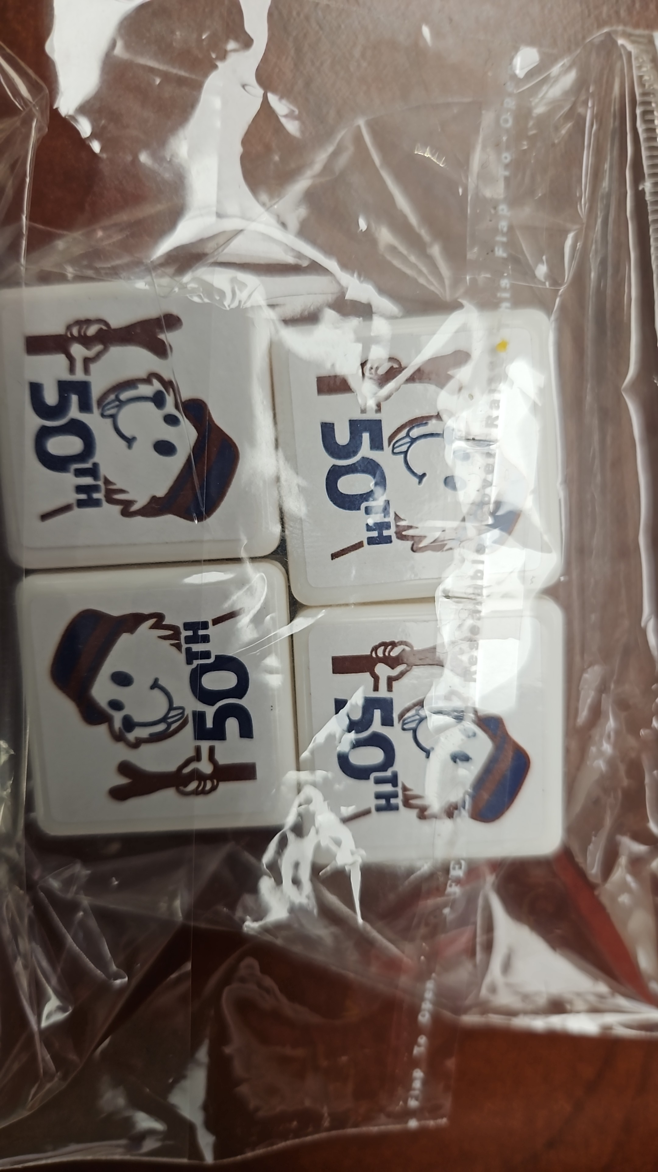
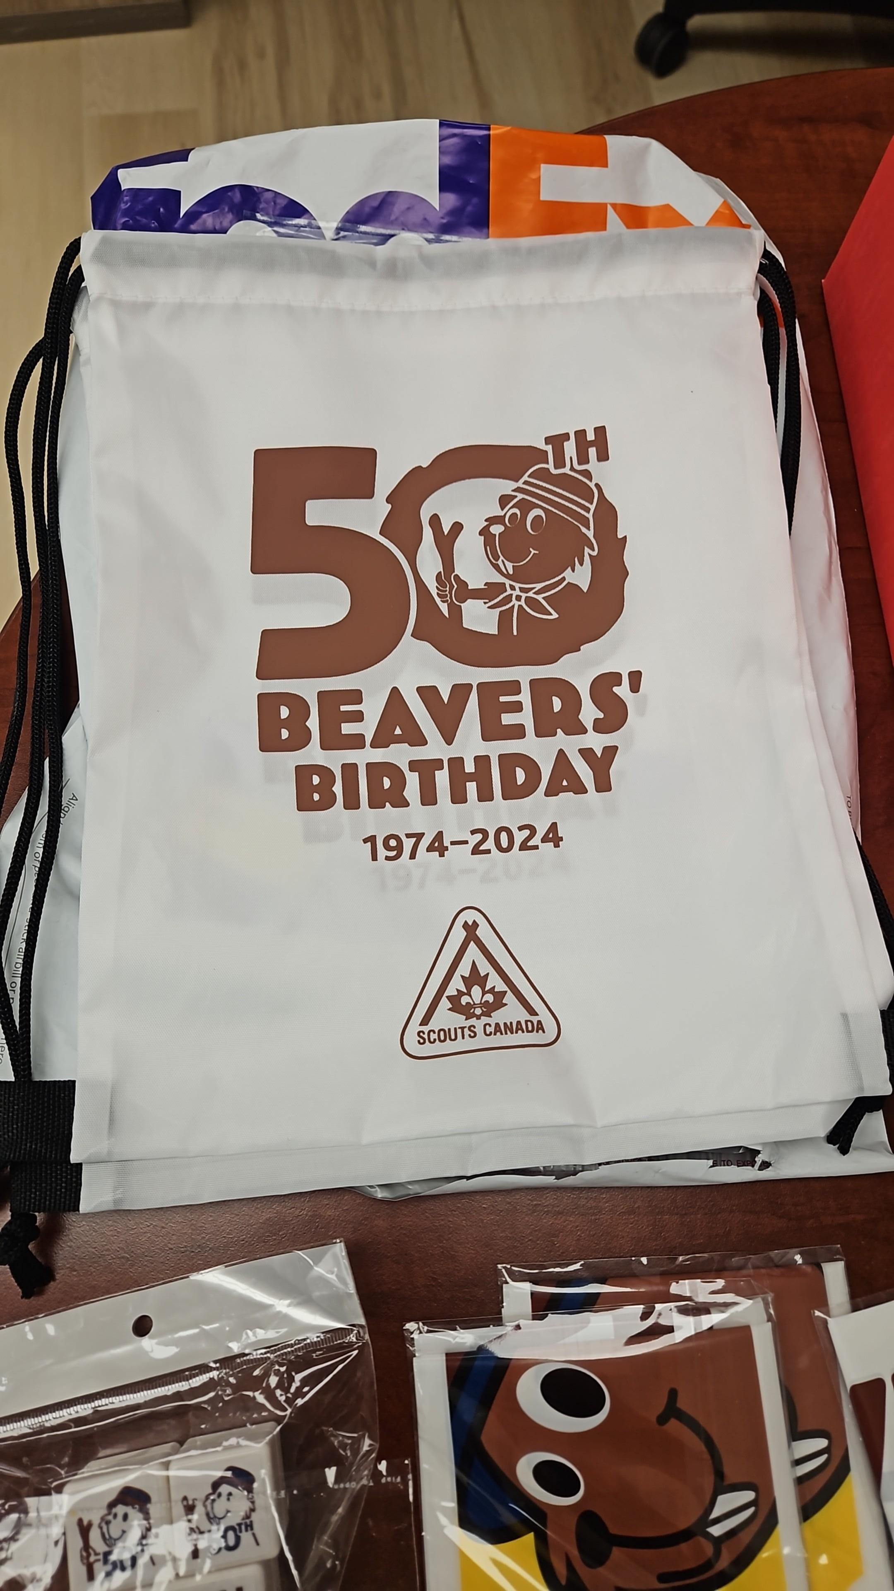
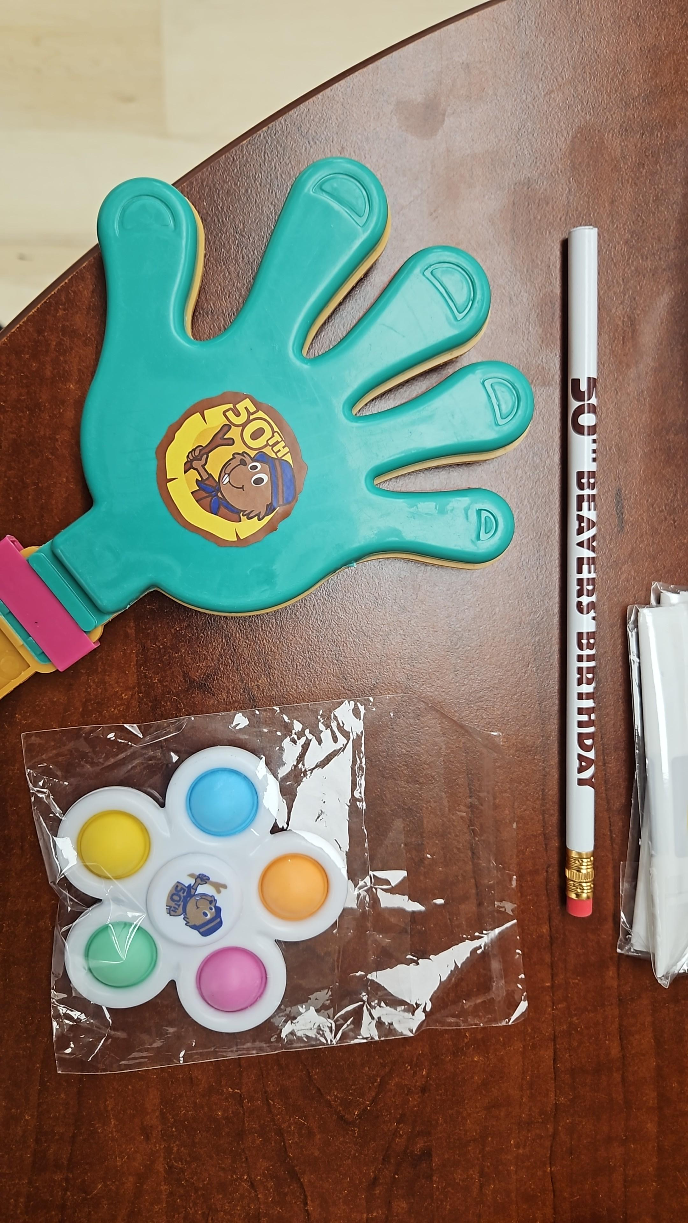
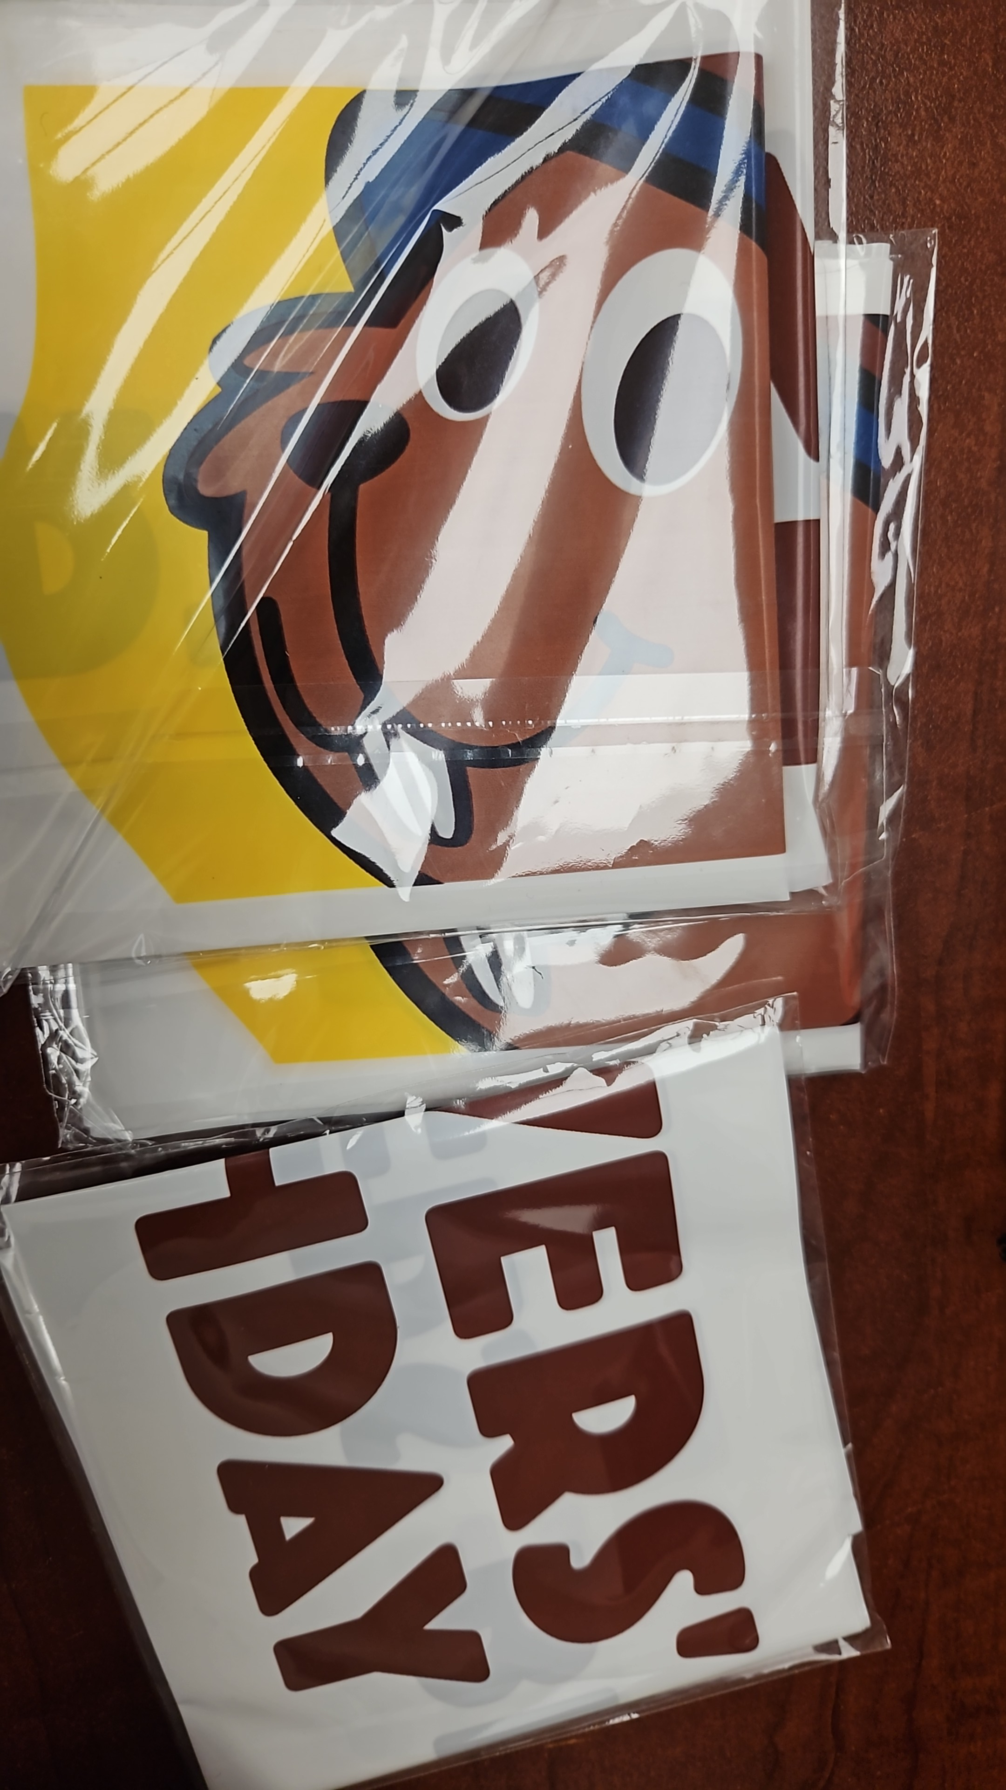
Plus….. Swag!

Slide 13
Timelines
Feb 1st, 2024
March 15, 2024
Mid-April
Early May
June 1st, 2024
Registration opens
Registration closes
Confirmation if catering will be available
Transportation hub confirmed
FUN!!

Slide 14

Registrations!
Due by March 15th!

Slide 15
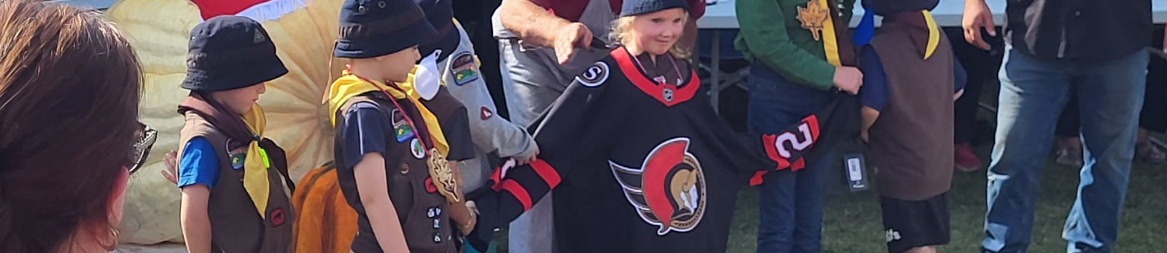
Attendance Cost
Base Pricing
Other councils…
Beavers: $50
Scouters: $50 (or $35 without swag)
Offer of Service: $30
Parent/Guardian: $35
Battlefields - $60/person with sleepover, no food or transportation
Toronto - $50/person, no food, no sleepover, and no transportation
DoubleKnot fees!

Slide 17
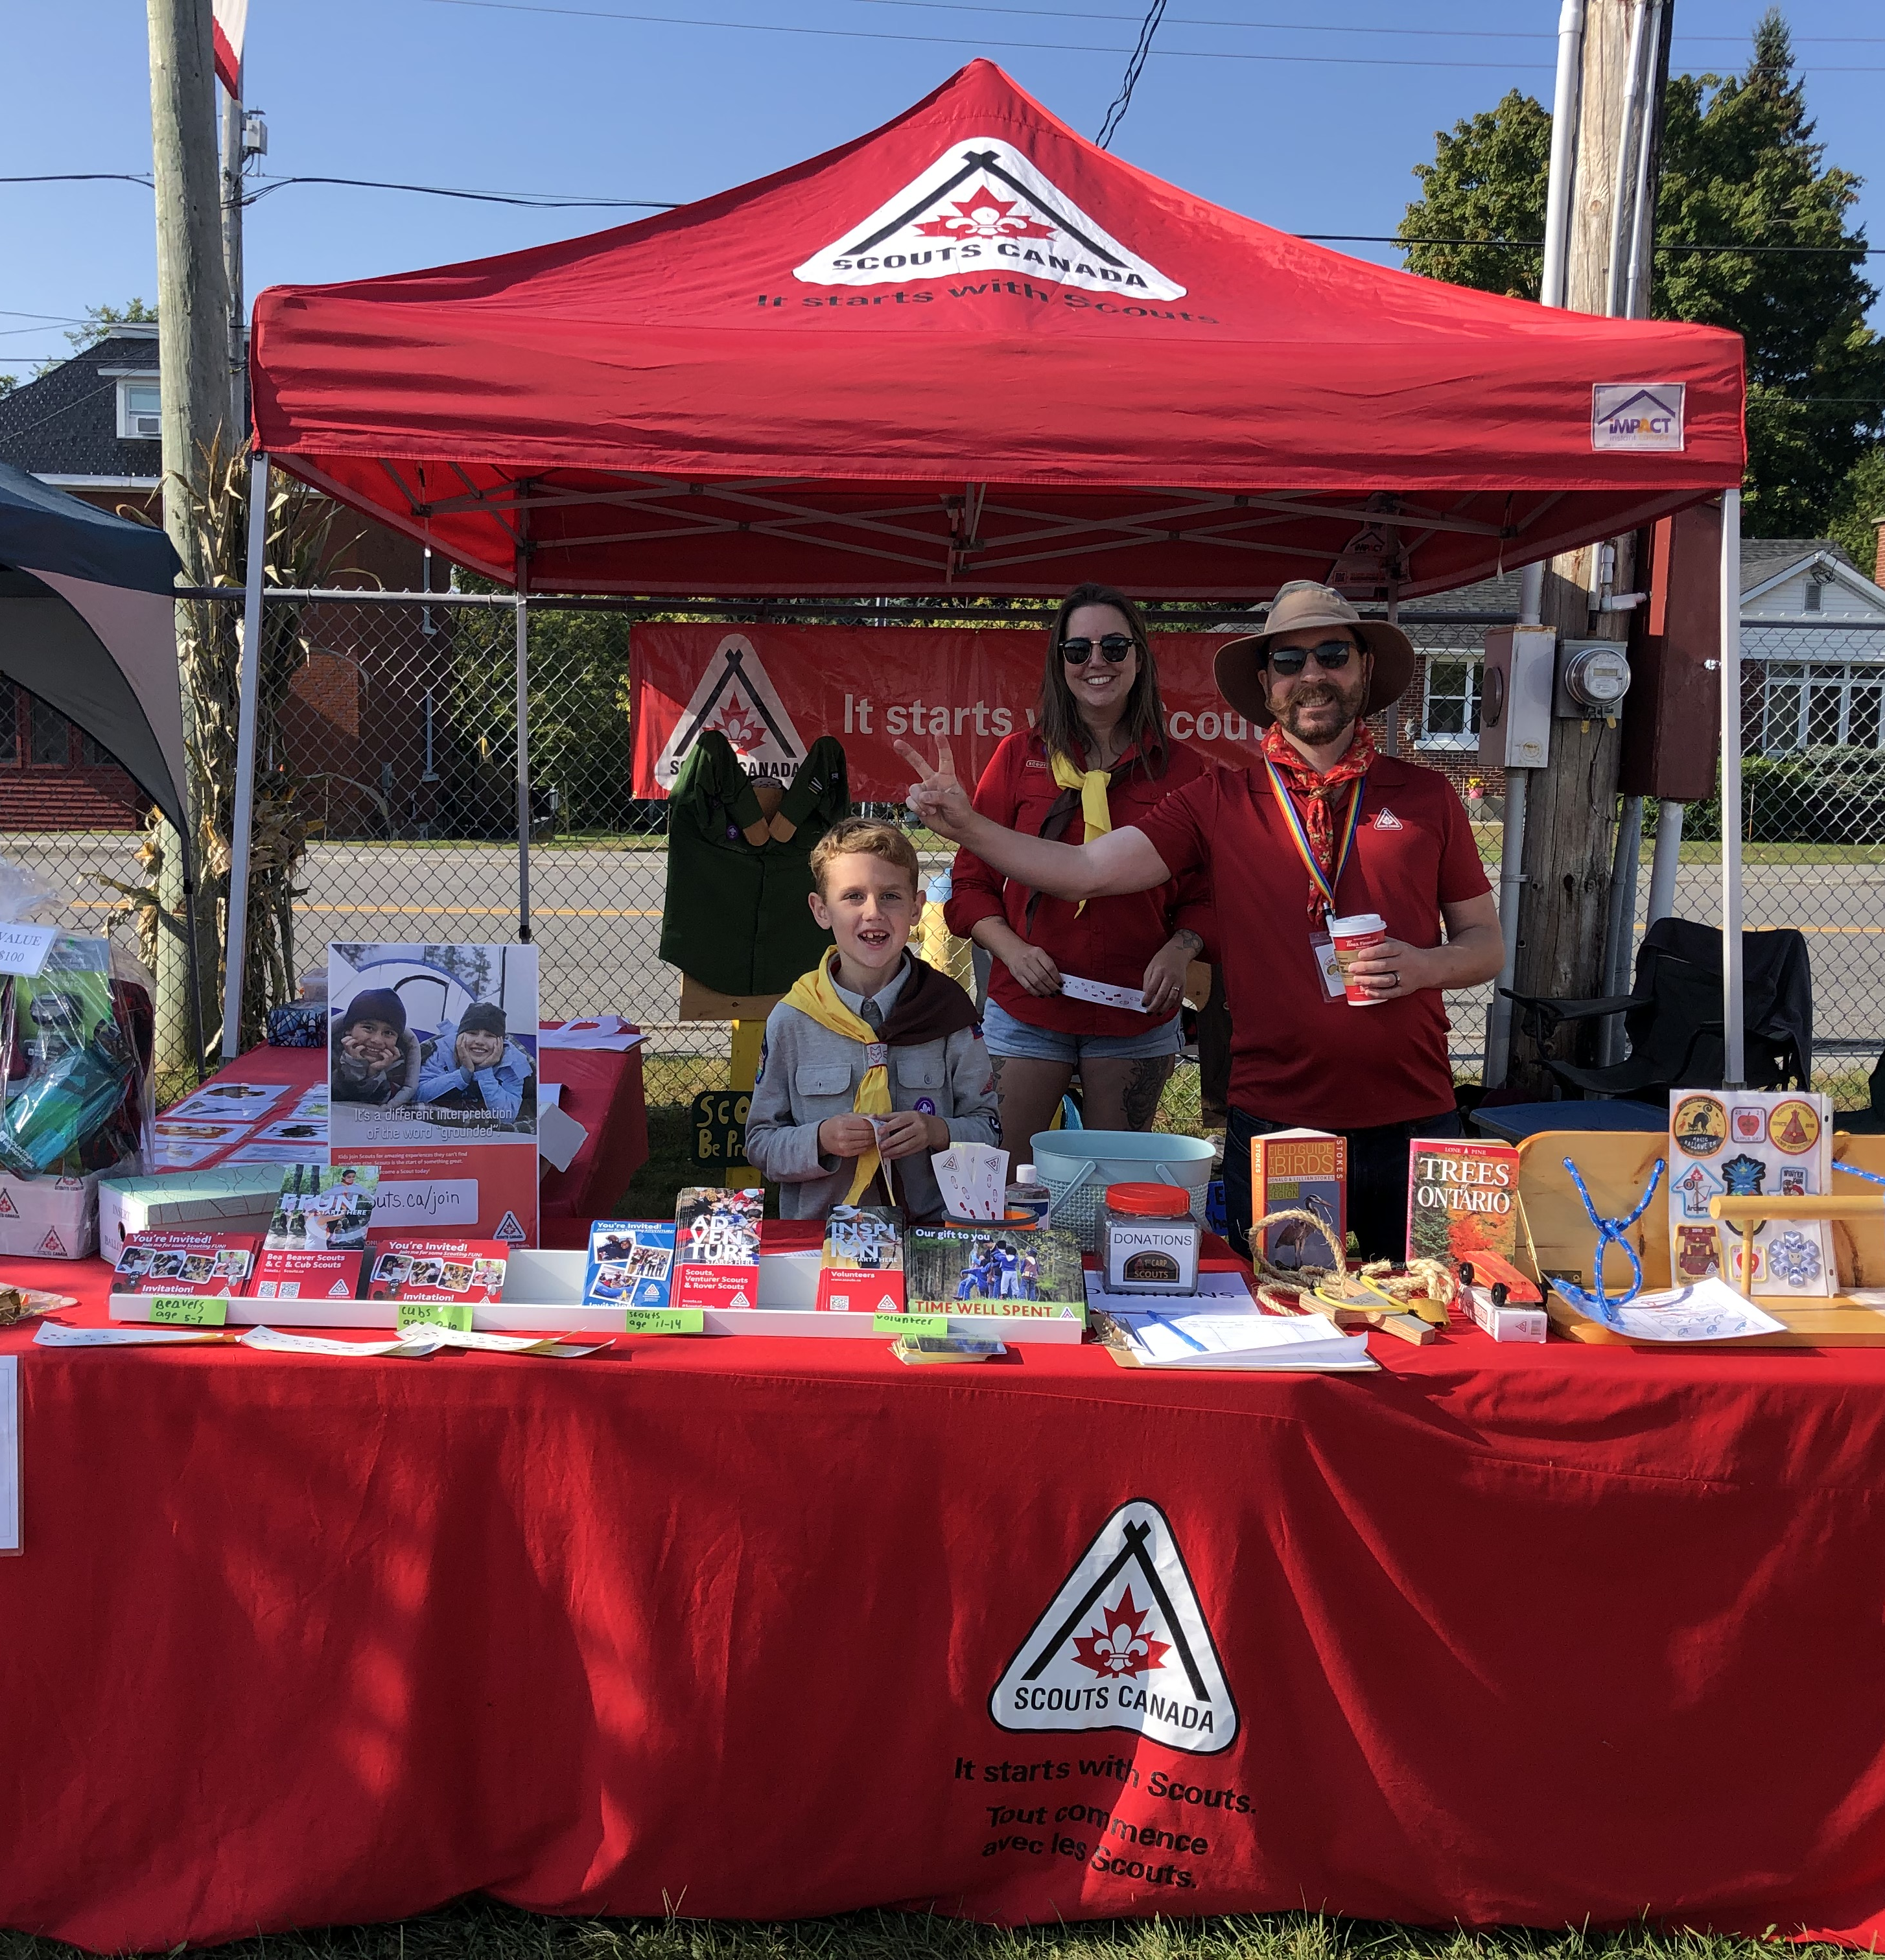
Resources!
Voyageur Beaver 50th Website!
https://www.beaver50th.ca/
Beaver 50th Newsletter
Sent out twice a month to all registered Beaver Scouters and GC’s in Voyageur.

Slide 18
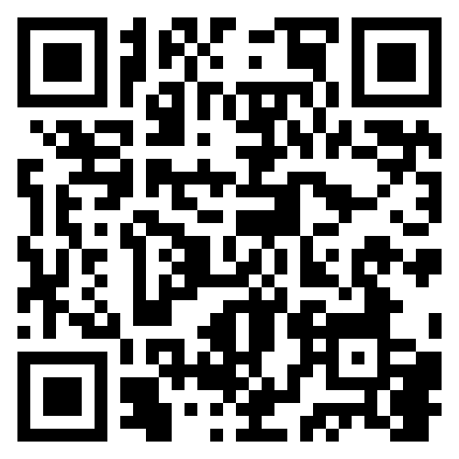
We Need Help!
Admin Team
Logistics Team
Program Team
Overall event management, attends key meetings
Site services & logistic planning
Activities and event scheduling, coordination
On-Site Team
Role Registration: https://forms.office.com/r/PHtE2gb2RR

Slide 19
Let’s make this special!
Please reach out to us if you have any suggestions or ideas for….
Vendors who would be a great addition to tie-in and help make this an amazing day
Any sponsorship ideas
If you’d like to help with the planning and running of this event for the youth!

Slide 20
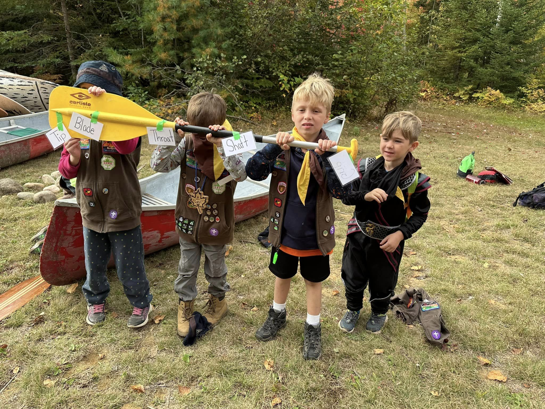
Q&A
What’s on your mind?

